Slide 1
Public access to chemical data supporting safety culture in academic research laboratories
Leah McEwen, Cornell University
Evan Bolton, National Library of Medicine
Steve Heller, National Institute of Standards and Technology
Pacifichem, December 2015

Slide 2
Abstract
Several recent high profile adverse laboratory events and subsequent reports published by the US Chemical Safety Board, the US National Research Council and the American Chemical Society (ACS) Committee on Chemical Safety indicated that a significant barrier to implementing hazard assessment strategies in a decentralized academic research and teaching environment is the effort required to collect and organize relevant chemical information and apply it in a local laboratory setting. Authoritative data is distributed across disparate sources, in multiple formats, using various systems of units and reporting standards. The ACS Divisions of Chemical Health and Safety (CHAS) and Chemical Information (CINF) are collaborating to assess and address these challenges pertaining to information discovery of chemical properties, reactivity hazards and mitigation options important for safety planning. Public databases such as PubChem, published by the US National Library of Medicine, aggregate information on tens of millions compounds from several hundred agency sources and other authorities internationally, and are implementing state-of-the-art Web technologies to improve data integration, including specific focus on chemical hazard and safety information. The International Union of Pure and Applied Chemistry (IUPAC) has developed and endorsed the IUPAC InChI chemical structure standard for chemical research materials to facilitate accurate linking across chemical databases and inventory systems in conjunction with the Global Harmonization System labels that document chemical hazard classification. This presentation will describe these efforts and demonstrate the impact on global availability of chemical information for supporting hazard assessment and management in academic research and teaching labs.

Slide 3
Professional Collaboration in Service
American Chemical Society (ACS) Division of Health & Safety (CHAS) Division of Chemical Information (CINF) Division of Chemical Education (CHED)
Service professional roles that support chemistry research and teaching
Member driven and coordinated effort

Slide 4
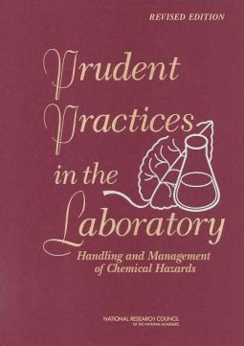
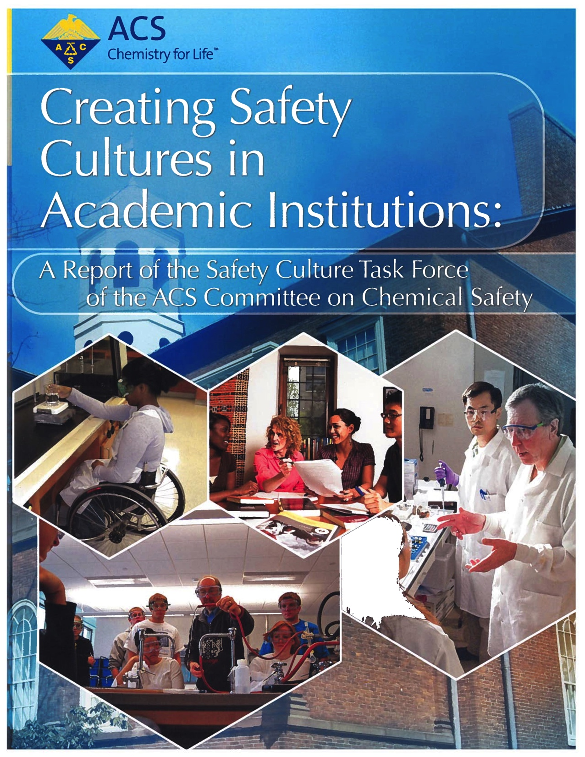
Goal: Culture of Safety
support academic chemical researchers in conducting lab experiments in a prudent manner within their local institutional context and physical environments

Slide 5
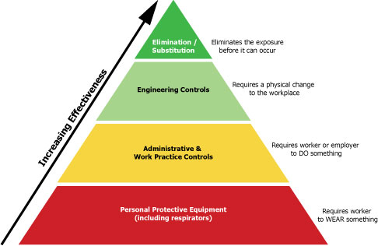
How Can We Support Prudent Practices?
Hazard alerts for synthesis planning
Profiling experimental procedures for control points
Flagging incompatibilities for storage and disposal
Mapping controls to exposure routes
Mapping responses to consequences
Retro- hazard analysis
facilitate hazard control planning by
improving linking among data types and sources
Notes:
These represent the decision points that stakeholders need to work through
Usually worked from the bottom up
What aspects do CHOs need to consider? PIs?
What aspects do researchers still need to consider at point of experimental planning and implementation?
And what information do they need for this?
Prevention It’s better to prevent waste than to treat or clean up waste afterwards.
Atom Economy Design synthetic methods to maximize the incorporation of all materials used in the process into the final product.
Less Hazardous Chemical Syntheses Design synthetic methods to use and generate substances that minimize toxicity to human health and the environment.
Designing Safer Chemicals Design chemical products to affect their desired function while minimizing their toxicity.
Safer Solvents and Auxiliaries Minimize the use of auxiliary substances wherever possible make them innocuous when used.
Design for Energy Efficiency Minimize the energy requirements of chemical processes and conduct synthetic methods at ambient temperature and pressure if possible.
Use of Renewable Feedstocks Use renewable raw material or feedstock rather whenever practicable.
Reduce Derivatives Minimize or avoid unnecessary derivatization if possible, which requires additional reagents and generate waste.
Catalysis Catalytic reagents are superior to stoichiometric reagents.
Design for Degradation Design chemical products so they break down into innocuous products that do not persist in the environment.
Real-time Analysis for Pollution Prevention Develop analytical methodologies needed to allow for real-time, in-process monitoring and control prior to the formation of hazardous substances.
Inherently Safer Chemistry for Accident Prevention Choose substances and the form of a substance used in a chemical process to minimize the potential for chemical accidents, including releases, explosions, and fires.

Slide 6
How Can We Support Safety Management?
Safety Data Sheets
Hazard Recognition
Risk Assessment
Controls, Protocols
Planning, Practice
Analyze, Adjust
Global Harmonization System
Lessons Learned
Chemical Inventories
Laboratory Ventilation Monitoring Programs
Job Hazard Analyses
Laboratory Chemical Safety Sheets
Chemical Safety Levels
Standard Operating Procedures
Laboratory Hygiene Training
streamline the risk assessment process by systematically managing the information flow

Slide 7
Challenges & Opportunities
3. Connecting different stakeholders
Research chemists
Chemical hygiene officers
Organizations (e.g., agencies, societies, research institutions, local/regional government)
Chemical information providers
2. Connecting people to information
Where they are, when they need it
1. Connecting disparate information sources
What they need, in local context of use
Notes:
Just like the control hierarchy, we can work from the bottom

Slide 8
Information Connections
ChemIDplus: A TOXNET DATABASE
Biological Safety Data Sheets
NIOSH Pocket Guide to Chemical Hazards
Does each organization (or scientist) use their own favorite data source(s)?
Do these various data sources provide consistent information (gaps, errors)?
How does the health and safety decision change with different information (or lack of it)?
http://www.csb.gov/
Pathogen Safety Data Sheets and Risk Assessment
SDS Search and Product Safety Center
International Chemical Safety Cards (ICSC)
SIRI MSDS Index
https://www.dol.gov/
SDS and Chemical Information from Manufacturers
http://www.sigmaaldrich.com/
TOXLINE: A TOXNET DATABASE
CHEMINDEX FREE on the WEB!
Right to Know Hazardous Substance Fact Sheets
Notes:
Lots of information is there, but…
Not found and not connected
Not consistent or easily pars-able
Not readily analyzed for appropriate scenario
what is original source…
GHS will help some, but still long way towards harmonization, esp on digital level

Slide 9
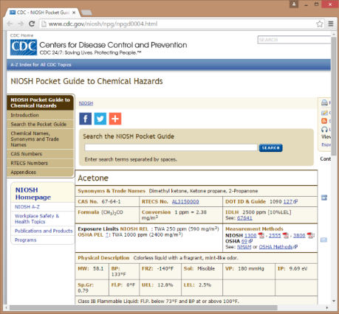
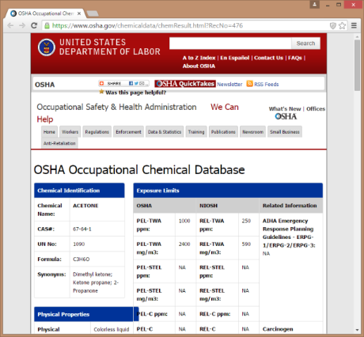
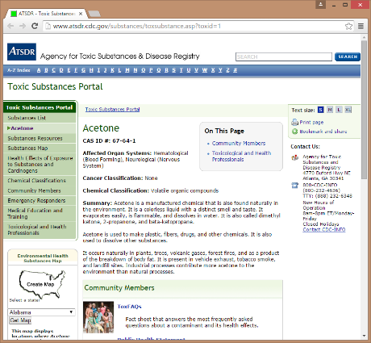
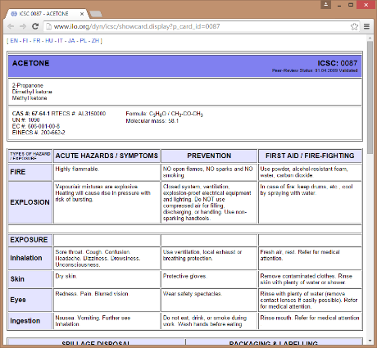
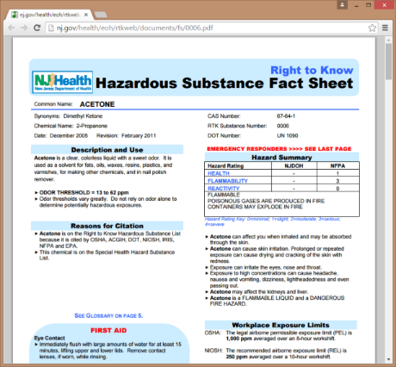
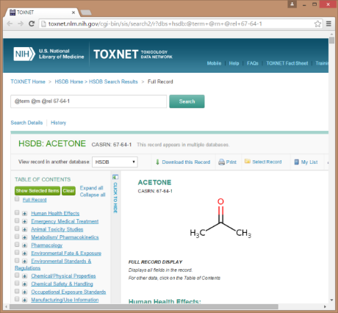
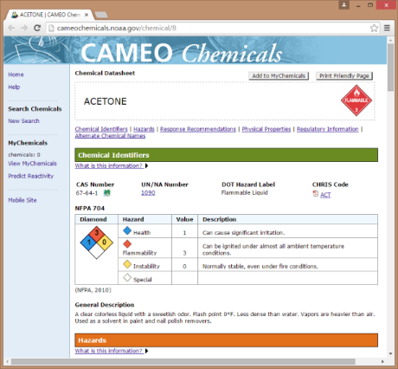
Data Source of Data Sources
By integrating these, a public repository such as PubChem can act as a one stop shop for data needs with links back to primary data sources
One chemical .. many useful sources
Each resource has some overlaps
Each resource has unique content
Acetone .. seven sources
CDC NIOSH, NJ HSFS, DOL OSHA, ILO ICSC, NLM HSDB, CDC ATSDR, EPA/NOAA CAMEO
What if you have ten chemicals?
What if you have ten sources for each?
How much time will one spend comparing these?
Notes:
As Ralph showed, PubChem as a data source (of data sources)
concise data view, w/ provenance
mapping normalized cmpd indexing to substance reality of the world
annotation & classification

Slide 10
Connecting Data to Needs
Information organization
Analysis functionality
Use cases
Data sources
-> most sources managed manually
-> most sources organized around a primary type of need or intended audience
-> flexibly structured ecosystem of data, workflow tools and domain expertise mapped to the essential commonalities of the use cases and content, connected by good information management practices

Slide 11
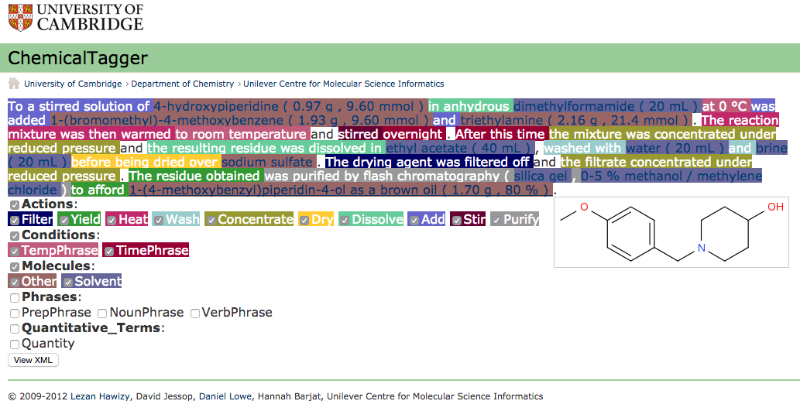
Profiling Procedures
http://chemicaltagger.ch.cam.ac.uk/
https://www.nextmovesoftware.com/casandra.html
Notes:
Profiling experimental procedures
breaks downs activities, we can use these to learn about impact on flow/temp/pressure/etc.]

Slide 12
Incompatibility Queries
“A mixture of acetone and chloroform in a residue bottle exploded. Since addition of acetone to chloroform in the presence of base will result in a highly exothermic reaction, it was thought that a base was in the bottle.” (Original source: MCA Case History 1661, 1970.)
Molecule and Molecule form Mixture then Cause Adverse_event Under Condition
form
then cause
(under)
in a residue bottle
Acetone
and
Chloroform
Mixture
exploded
base was in the bottle
Action of Cause:Molecule to Theme:Molecule Cause Adverse_event Under Condition
Addition
of
Acetone
to
Chloroform
cause
highly exothermic reaction
(under)
in the presence of base
Query: Under what conditions could the mixture of Acetone and what molecules cause an adverse event?
Notes:
Querying conditions for incompatibility
Retro-hazard analysis

Slide 13
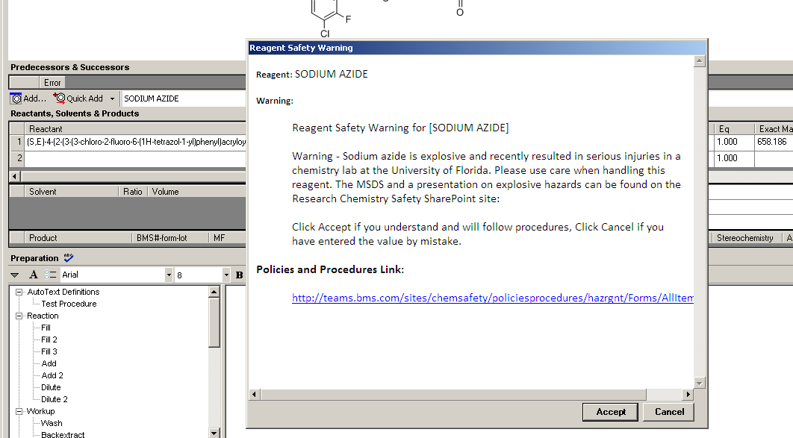
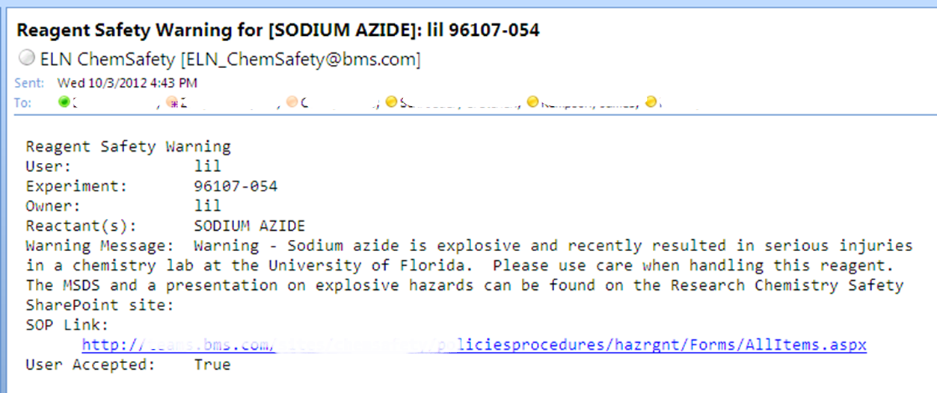
Reaction Incidents
Pistoia Alliance Chemical Safety Library Project (CSL)
Collaborative project across Life Sciences industry to enhance both the safety information available, and its delivery.
Will capture and openly share data of actual reaction incidents
Defining a submission system to collect the new data
To find out more or join the interest community, https://main.qmarkets.org/live/pistoia/node/1365
For more on the Pistoia Alliance, http://www.pistoiaalliance.org/
Notes:
Hazard alerts for synthesis planning

Slide 14
Activating the Data
Linkable chemical identifiers
Chemical Safety Ontology (CSO)
Reactivity classification
Lab process description

Slide 15
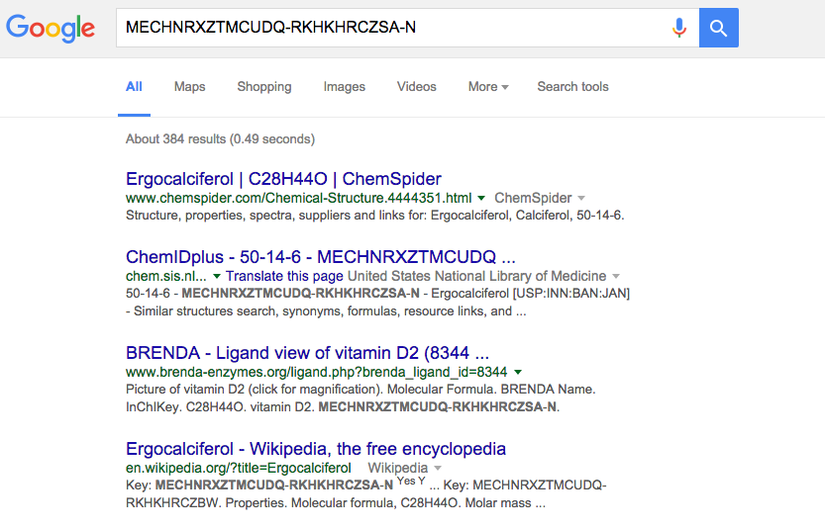
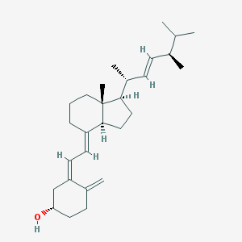
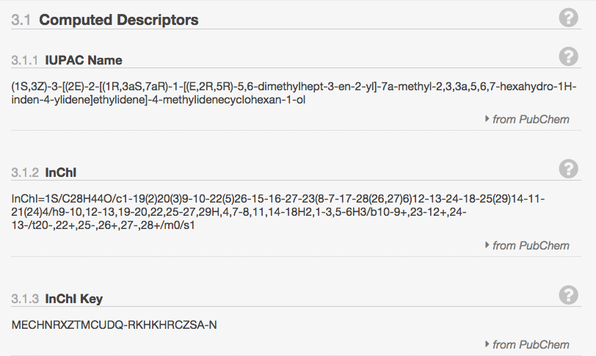
Linkable Chemical Identifiers
Limitations with CAS RNs and trivial names
Lack of notation for mixtures and states
Not computer readable
-> link across internal and external databases
-> more readily searchable (Google-able)
-> resolve to 2D chemical structures
-> free and open to use and validate
→ IUPAC InChI

Slide 16
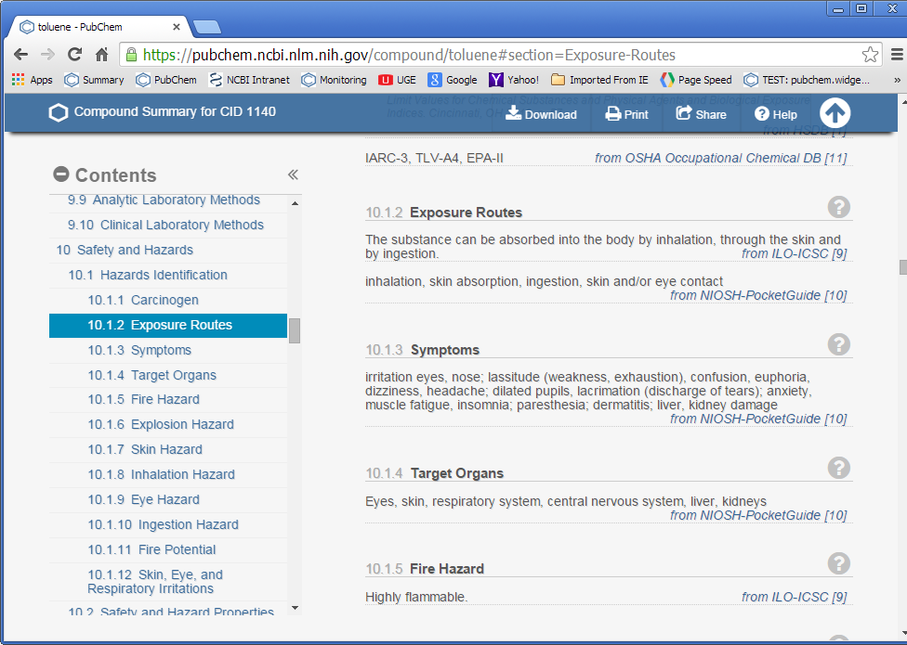
Chemical Safety Ontology
This text can be a useful source of concepts to add to a Chemical Safety Ontology.
Use the ontology to index all exposure routes described across all chemicals in a database.
Notes:
Professional safety terminologies
Vendor SDS and GHS documentation
Institution incident reports
EHS SOPs and risk analyses
Published article cautionary notation

Slide 17
Chemical Safety Ontology
Professional safety terminologies
Vendor SDS and GHS documentation
Institution incident reports
EHS SOPs and risk analyses
Published article cautionary notation
Notes:
Safety terminology - ILO IPCS, Gottschalk & Walker - Need to work on a unified safety terminology, like UAT or AGROVOC
More GHS documentation – ILO, ECHA, NITE, need more from vendors
incidents, Lessons Learned – Pistoia Chemical Safety Library
EHS SOPs and risk analyses
cautionary notation – compiled from possible journal reporting requirements?

Slide 18
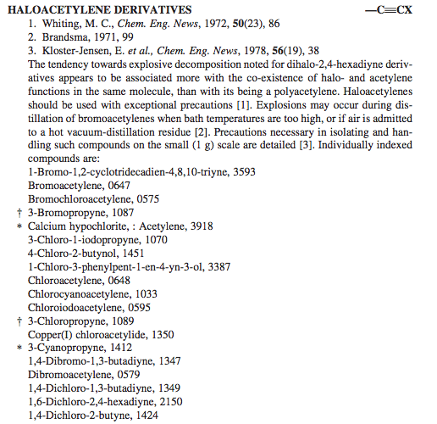
Reactivity Classification
3-Bromopropyne
Acetylenes
SMARTS: [#6]#[#6]
2-Butyne, 1-azido-4-chloro-
Acetylene Azides
SMARTS: [#6]#[#6]-[#7-]-[#7+]#[#7]
Bretherick’s Handbook of Reactive Chemical Hazards (7th ed.) Urben and Bretherick; 2006 Elsevier Ltd.
Notes:
Reactivity classification for storage and disposal

Slide 19
Lab Process Description
Notes:
process description (process ‘ingredients’ and how related, ala bowtie))
- Could enable analysis of lessons learned about contributing factors, weak areas of control, etc.

Slide 20
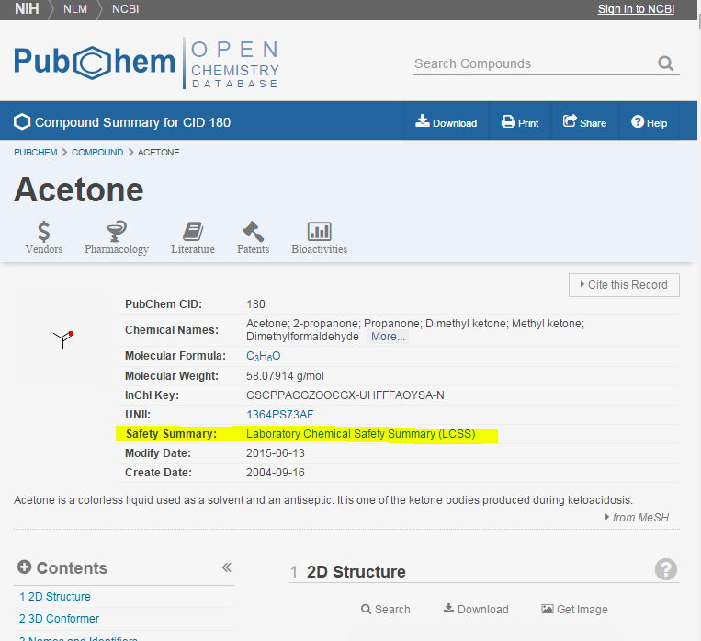
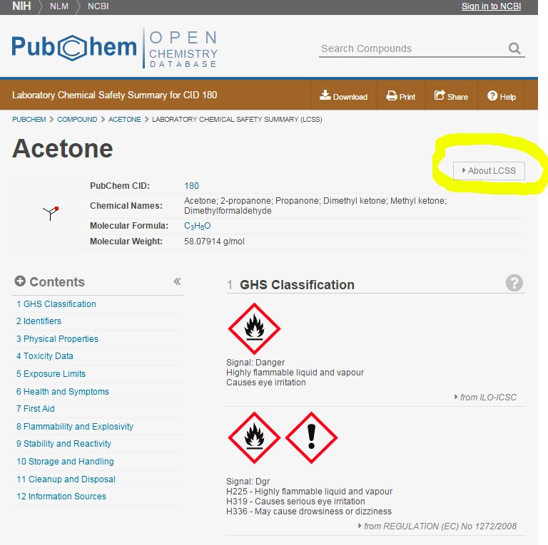
Emerging Opportunities
Well organized compilation of relevant data and information from across authoritative sources for millions of chemicals
Index and search by compound or substance
Group relevant data types together
Track source provenance
Highlight key safety concepts
Classify by hazards and other properties
Notes:
Ralph showed some use cases, others emerging, like campus inventory/information delivery systems

Slide 21
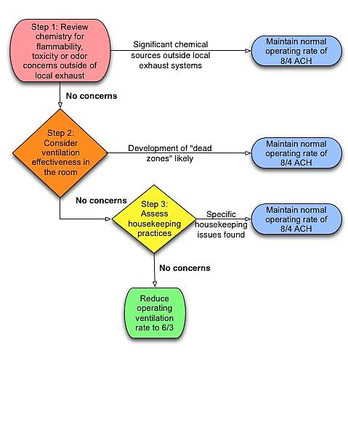
Emerging Opportunities
Well organized compilation of relevant data and information from across authoritative sources for millions of chemicals
Ability to pipe this organized data stream into local systems
Campus inventories
Safety protocols, training
Experimental planning tools (e.g., lab notebooks)
Teaching lab procedures
Notes:
Ralph showed some use cases, others emerging, like campus inventory/information delivery systems

Slide 22
Call to Action!
More chemical safety data sources
-> what types of chemical data do you need to see more?
Professional review of data stream
-> which sources are appropriate for which types of safety scenarios and questions?
-> how can we improve use of data by more institutions?
Safety related terminology and classification
-> which lab safety concepts are current and useful?
Professional safety community documentation
-> how can we collect procedures, risk analyses, and incident reports developed by professional safety offices?

Slide 23
References
Emerging Opportunities in Chemical Safety Information, Stuart, McEwen and Bolton. December 2015 CINF Webinar http://acscinf.org/content/webinars
PubChem Laboratory Chemical Safety Summary, Kim et al. Fall 2015 ACS CHED CCCE Newsletter http://confchem.ccce.divched.org/2015FallCCCENLP3
The Safety “Use Case”: Co-Developing Chemical Information Management and Laboratory Safety Skills, Stuart and McEwen, Journal of Chemical Education Oct 2015http://pubs.acs.org/doi/abs/10.1021/acs.jchemed.5b00511
Meeting the Google Expectation for Chemical Safety Information: Chemical Risk Assessment in Academic Research and Teaching, Chemistry International Sept 2015, McEwen and Stuart http://www.degruyter.com/view/j/ci.2015.37.issue-5-6/ci-2015-0505/ci-2015-0505.xml?format=INT

Slide 24
Questions?
U. Minnesota 2014-06-17

