Slide 1


July, 2017
ACS Chemical Safety Tools
Samuella Sigmann, CCHO
Appalachian State University, Boone, NC
Ralph Stuart, CIH, CCHO
Chemical Hygiene Officer, Keene State College, Keene, NH

Slide 2


Who We Are
Sammye: Chemical Hygiene Officer (CHO) at Appalachian State Chemistry Department; incoming chair-elect of DCHAS; foreign experience in Kurdistan
Ralph: CHO at Keene State; former CHO at Cornell University, where I was involved in lab safety training for the global audience visiting Cornell; chair of the ACS Safety Advisory Panel

Slide 3

Goals of the Workshop
Review the lab chemical safety tools developed by the ACS since the CSB report in 2011
Practice with these tools and place them in the context of an academic chemical safety program
Discuss the strengths and weaknesses of these tools and generate ideas for future ACS tools

Slide 4
American Chemical Society
The ACS has over 150,000 members from academia, industry and government.
It publishes 50+ academic journals, C&E News and Chemical Abstracts Services; it also has advocacy and leadership roles in the chemical enterprise.
Its structure is similar to academia:
  32 technical divisions (analogous to departments),
  42 governance committees
  (analogous to a Faculty Senate) and
  Staff (analogous to administration) headquartered in Washington DC and Columbus, Ohio.

Slide 5
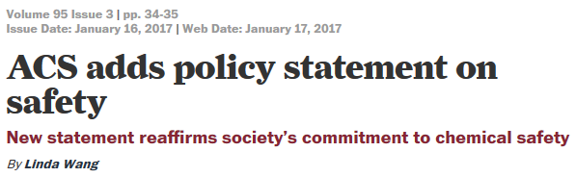


Safety in ACS Policy
Division of Chemical Health and Safety
Division of Chemical Information
Division of Chemical Education

Slide 6

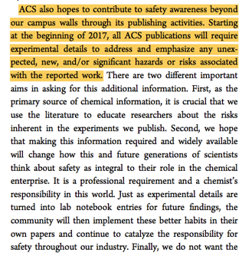
ACS and Safety in Academic Labs
Safety in Research
Goal 3: Support Excellence in Education
ACS will support reforms and initiatives that result in highly effective chemistry education, safer laboratory practices, and a pipeline of technically competent, ethical, and competitive chemists ready to address global challenges. Through educational resources, instruction, and mentorship, ACS and its members will promote principles of safety and ethics throughout pre-college, undergraduate, graduate, and post-graduate education. The Society will promote the development and dissemination of evidence-based practices in chemistry education to foster a scientifically literate citizenry and ensure a highly qualified chemical workforce.

Slide 7
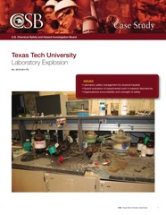
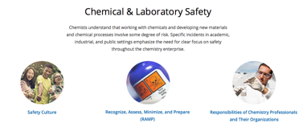
Selected ACS Safety Resources
(since 2011)
Identifying and Evaluating Hazards in Research Laboratories 2013
Guidelines for Bachelor’s Degree Programs Safety Supplement, 2015
PubChem Laboratory Chemical Safety Summaries, 2015
Guidelines for Chemical Laboratory Safety in Secondary Schools, 2016
Guidelines for Chemical Laboratory Safety in Academic Institutions, 2016
CHED Safety Committee demonstration guidelines, 2016
ACS Journals Publication Policy, 2016
Hazard Assessment in Research Laboratories web site
Five Key Questions for Safe Research and Demos
inChemistry, 2016
Bowtie symposium and article, 2016 - 2017
Chemistry Risk Assessment Survey, 2017
Safety Guidelines for the Chemistry Professional, 2017
Safety in Academic Chemistry Labs, 8th Edition, 2017
Chemical Safety webinars, 2017
Video evaluation rubric, in process
Links available from http://www.acs.org/safety

Slide 8
The Structure of ACS Safety Resources
Technical
Cultural
High School
Undergraduate teaching labs
“Mentored” research labs
Research
lab work
  Guidelines for Chemical Laboratory Safety in Secondary Schools, 2016
  SOCED’s Guidelines and Recommendations for the Teaching of High School Chemistry, 2012
  Safety in Academic Chemistry Laboratories (SACL), 8th edition, 2017
  Guidelines for Bachelor’s Degree Programs - Safety Supplement, Committee on Professional Training, 2015
  Guidelines for Chemical Laboratory Safety in Academic Institutions, 2016
  Safe Science, National Research Council, 2014
  Hazard Assessment in Research Laboratories, 2016
  ACS journals policy, 2016

Slide 9
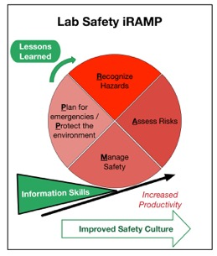
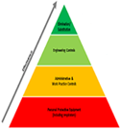

The Strategy for
Moving Lab Safety into the 21st Century
20th Century:
Selecting Controls
Based on Rules, guided by Chemical Intuition
21st Century:
a Safety System based
on documented
Risk Assessment
Identify Hazards from previous events
Culture Change through Safety Education

Slide 10

Changes in the ACS Approach to Chemical Safety since 2011
Technical focus of safety changed from hazard identification to risk assessment processes
Safety management based on rules to development of a resilient safety system
Safety Culture based on compliance to a one based on leadership and empowerment
Safety information as a training topic to an educational subject that involves research skills including chemical information literacy, communication, teamwork and ethics

Slide 11
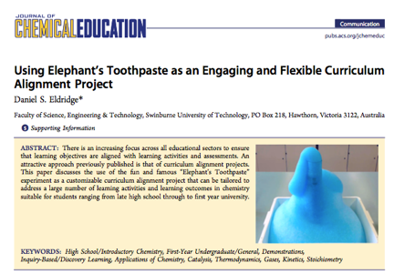
Evaluating the Chemical Education Literature using the Emerging Approach
Which of these aspects does
the article demonstrate?
Risk assessment
Safety system
Leadership and empowerment
Educational topic

Slide 12

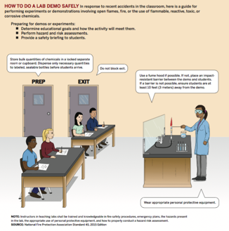
Technical Chemical Safety Tools

Slide 13

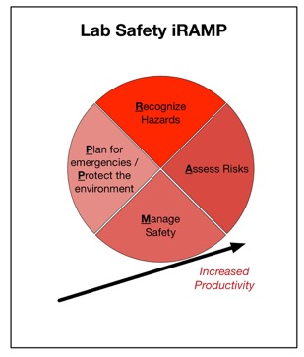
Building the System:
The RAMP Chemical Safety Process
Recognize:
What are the chemical hazards?
Assess:
What are the most important risks?
Manage:
How are we going to control the risks?
Prepare:
What emergencies should we plan for?
Protect the Environment:
How will we manage the wastes?
Add cultural aspects of the iRAMP

Slide 14
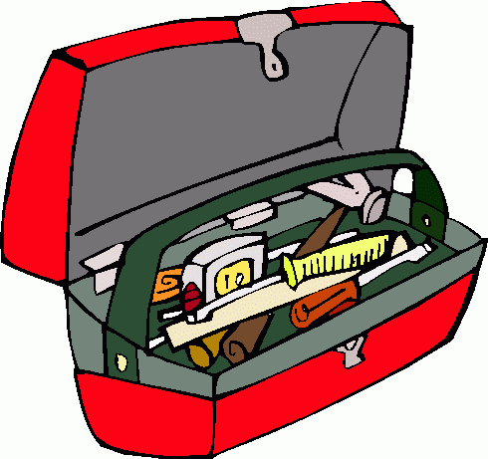
Technical Tools We’ll Explore
Recognize:
GHS and PubChem LCSS
Assess:
CHARLIE tools, particularly Job Hazard Assessments
Manage and Plan/Protect:
5 questions article
Iterate tools:
  Lessons Learned: Bowtie Diagrams
  Demonstration Review Rubric

Slide 15











Recognize:
Organizing Chemical Safety Information
NIOSH Pocket Guide to Chemical Hazards
GHS is a hazard banding system that identifies the key data to assign hazard rankings
The bands address generic scenarios and ignores data that could be relevant in some situations (e.g. auto-ignition temperature).
The assessment rankings reflect concentration information, but not quantity
Right to Know Hazardous Substance Fact Sheets
SDS and Chemical Information from Manufacturers

Slide 16
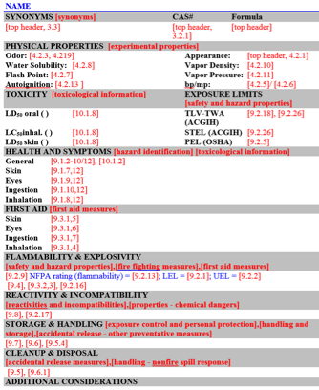
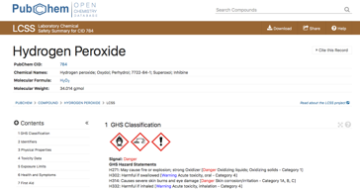
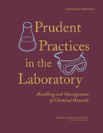
The Inspiration: LCSS from Prudent Practices
Notes:
*Low hanging fruit, done almost immediately based on community practices
PubChem is a publicly supported and accessible resource that sources data from authoritative chemical safety agencies
First step – very quick and efficient low hanging fruit
A- Map a Laboratory Chemical Safety Summary (LCSS) view in PubChem, based on community developed form
B- Flexible data structure enabled rapid development of dynamic view from many sources
C- Provides linking and contextual provenance of source data
provenance for authority – to support prof. judgment, and support rationale documentation later
provenance represents a key relationship of professionals and their data

Slide 17
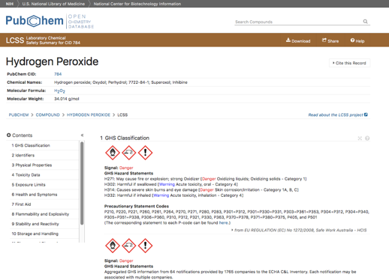
PubChem LCSS’s:
Safety Data based on GHS
Safety information on 103,000 chemicals
Includes SDS-style information as well as specific reaction information between chemicals
All of this safety data can be downloaded and stored locally

Slide 18
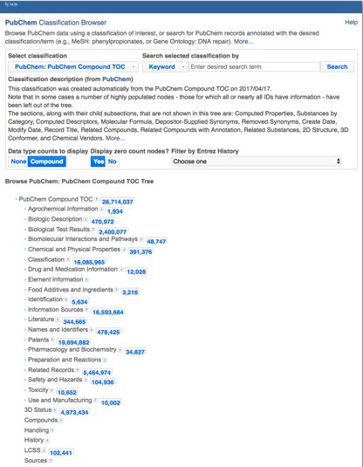
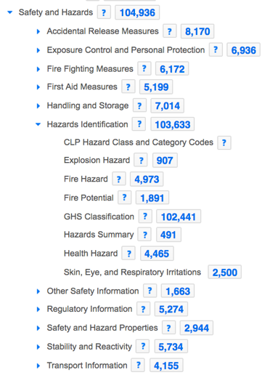
How much chemical safety data
is in PubChem?

Slide 19
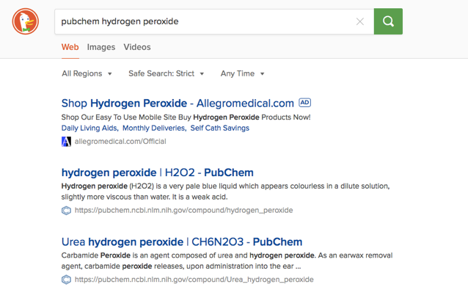
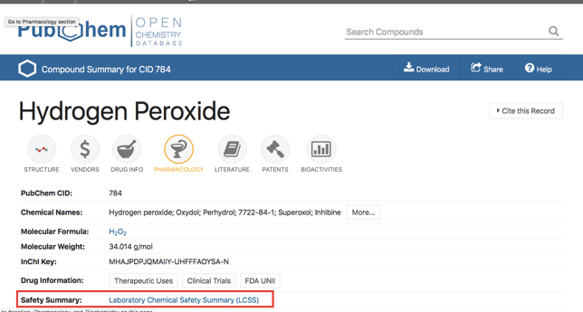
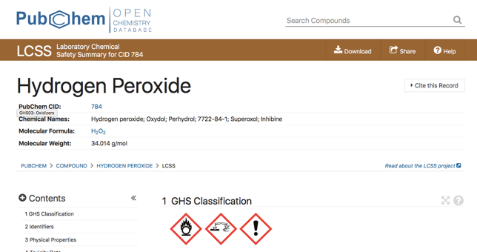
Accessing LCSS in PubChem
1. Google “Pubchem Chemical Name”
2. H₂O₂ PubChem home page
3. H₂O₂ PubChem LCSS

Slide 20
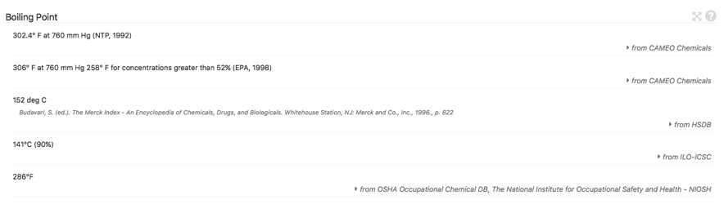
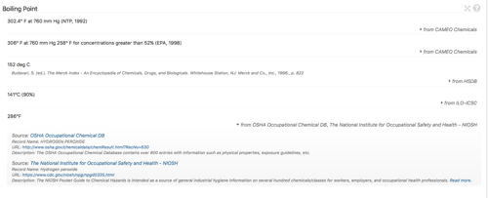
Key Feature of the LCSS
LCSS consolidates available health and safety data in order to:
enable rapid examination of data to assess agreement between sources
provide a clear provenance trail to understand differences
Notes:
*Low hanging fruit, done almost immediately based on community practices
PubChem is a publicly supported and accessible resource that sources data from authoritative chemical safety agencies
First step – very quick and efficient low hanging fruit
A- Map a Laboratory Chemical Safety Summary (LCSS) view in PubChem, based on community developed form
B- Flexible data structure enabled rapid development of dynamic view from many sources
C- Provides linking and contextual provenance of source data
provenance for authority – to support prof. judgment, and support rationale documentation later
provenance represents a key relationship of professionals and their data

Slide 21
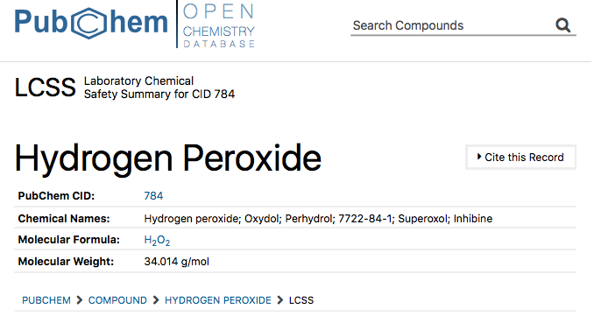
Drilling into the LCSS

Slide 22
Using the Data Stream
UC Chemicals – Pilot
Univ of California chemical inventory
mobile mgmt. tool
via PubChem
Notes:
The University of California is using this data stream in their mobile app for managing chemicals and information across all 10 campuses.

Slide 23

Programmatic download of data
Per compound from the LCSS data view: XML, JSON
Programmatically per heading per compound via URI-based API
Bulk ftp:
ftp://ftp.ncbi.nlm.nih.gov/pubchem/Compound/Extras/CID-LCSS.xml.gz
  Compressed XML file containing the compound summary data for all LCSS records within the PubChem Compound database
  Updated on a daily basis (subject to PubChem’s daily update cycle)

Slide 24
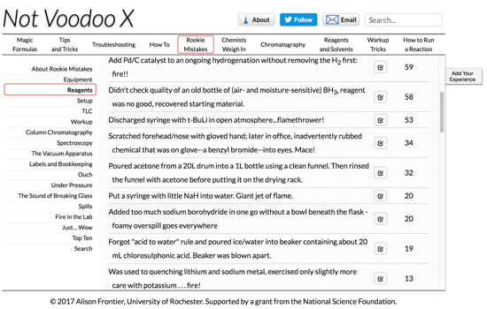
Moving Beyond Control Bands to include Process Hazards
Chemicals-oriented:
Bretherick’s Handbook of Reactive Chemical Hazards
Process oriented: Not VooDoo X
http://chem.rochester.edu/~nvd/

Slide 25
Information Models of
Reaction incidents from Bretherick’s
Acetone will be oxidized with explosive violence if brought into contact with the mixed (nitrating) acids, particularly under confinement.
/Acetone/ Interaction in presence of powdered potassium hydroxide (or other bases) is violently exothermic, even in presence of diluting solvents.
During bromination of acetone to bromoacetone, presence of a large excess of bromine must be avoided to prevent sudden and violent reaction.
The use of chromium trioxide to purify acetone is hazardous, ignition on contact occurring at ambient temperature.
Acetone and hydrogen peroxide readily form explosive dimeric and trimeric cyclic peroxides, particularly during evaporation of the mixture.
Bretherick, L. Handbook of Reactive Chemical Hazards. 4th ed. Boston, MA: Butterworth-Heinemann Ltd., 1990

Slide 26
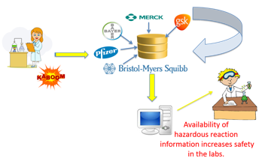
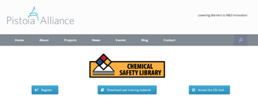
A Crowdsourced Approach
to Reactive Data Collection
Pistoia Alliance Chemical Safety Library (2017)
Information on specific lab scale chemical incidents
Access is free upon registration and reporting of incidents is encouraged.
Notes:
red boxes are processes, brown boxes are participants
processes can have as many participants as they want, processes can be linked successively
1- Black arrows indicate direction of participation relationship
2- Green lines indicate succession relationship (reverse OreChem)
Chemical processes planning/enactment split
Planning relates processes to other processes and it prospective.
Such-and-such a process follows another.
Enactment relates the products of processes to other products of processes and is retrospective.
Such-and-such an artefact is produced from another.

Slide 27
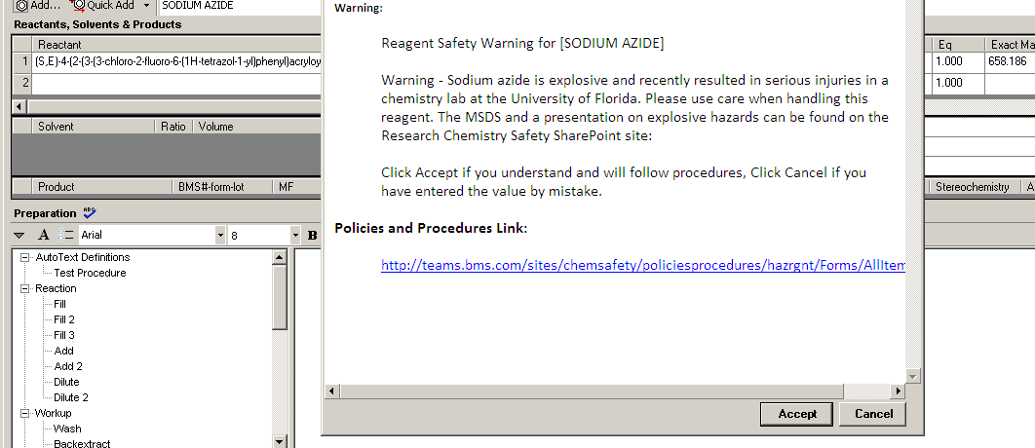
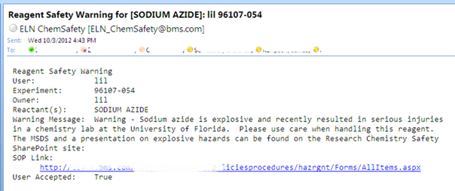
The Electronic Lab Notebook Approach
*Exemplar Application*
BMS Electronic Notebook
Alerting System
Originally based on an Sharepoint / Excel platform, which did not scale well.

Slide 28
References Looking Forward
Emerging Opportunities in Chemical Safety Information, Stuart, McEwen and Bolton. 2015 CINF Webinar: http://acscinf.org/content/webinars
PubChem Laboratory Chemical Safety Summary, Kim et al. Fall 2015
ACS CHED CCCE Newsletter: http://confchem.ccce.divched.org/2015FallCCCENLP3
Meeting the Google Expectation for Chemical Safety Information: Chemical Risk Assessment in Academic Research and Teaching, Chemistry International, McEwen and Stuart. 2015
The Safety “Use Case”: Co-Developing Chemical Information Management and Laboratory Safety Skills, Journal of Chemical Education, Stuart and McEwen, 2016
Teaching Chemical Safety and Information Skills Using Risk Assessment, in Integrating Information Literacy into the Chemistry Curriculum, Sigmann and McEwen, 2016
Chemical Health and Safety Data Management: Supporting Prudent Practices in Research Laboratories, Chemistry International, McEwen, 2017
PubChem: A source of laboratory chemical safety information, Bolton. June 2017 NCBI Webinar: https://youtu.be/-eNxsNd8sC4 (materials: https://go.usa.gov/xNkTx)

Slide 29

In Today’s World, Survey Says…
Spring 2017 ACS survey of 283 chemists asked (among other things):
“Where do you primarily search for lab safety and hazard information?”
66% say that the Safety Data Sheet is a trusted source

Slide 30
Most Useful Sections of SDSs
Tier 1 (>80%)
Section 2- Hazards
Tier 2 (40-50%)
Section 8- Exposure Controls/Personal Protection
Section 7- Handling and Storage
Section 10- Stability and Reactivity
Section 13- Disposal Considerations

Slide 31
Notes:
1/3 of respondents are at least moderately comfortable with their knowledge of ghs. 10/97 report being “unfamiliar” with Signal words which is where the assessment process begins.

Slide 32
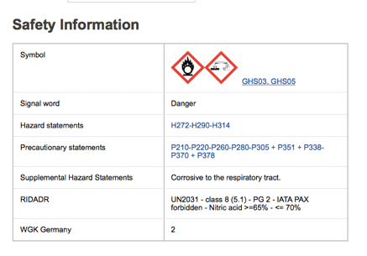
Critical Reading of SDS’s
Comparing two SDS’s for Nitric Acid

Slide 33

Elephant’s Toothpaste JHA

Slide 34
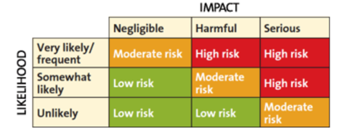
Manage: Building a Safety System
Five questions that everyone in the lab should be able to answer:
  What are the most important chemical (GHS) and process (physical) hazards associated with this work?
  What ventilation is required for this work and why?
  What Personal Protective Equipment is required for this work and why?
  What emergencies should we be ready for?
  What wastes will be generated and where will they go?

Slide 35
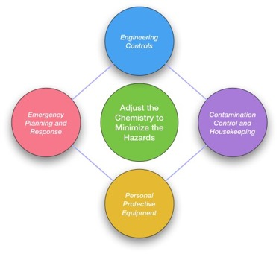
Lab Safety requires a System,
not a Solution
Managing chemical hazards in the lab involves coordinating 5 strategies organized into a resilient system:
  Hazard Analysis and Reduction
  Engineering Controls
  Training and Oversight
  Personal Protective Equipment
  Emergency Planning and Environmental Protection

Slide 36
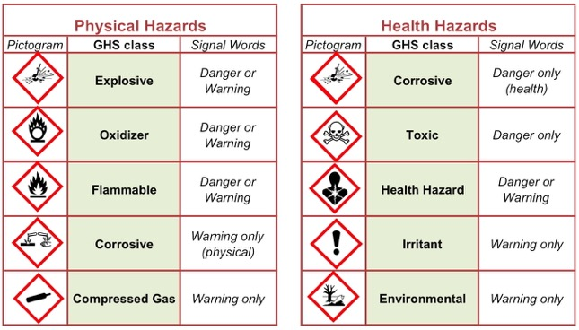
Question 1: What are the Chemical and Process Hazards?
The GHS Pictograms, Signal Words and Hazard Statements identify chemical hazards associated with your work. Look especially for the “DANGER” signal word to identify high hazard chemicals – these are chemicals that require special planning.

Slide 37
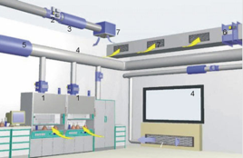
Question 2: What Ventilation Do I Need?
How much ventilation you need will depend on the fire and toxicity hazards associated with the demonstration or experiment.
“Lab ventilation” means that there is no air recirculated. The amount of room ventilation can vary:
No Lab Ventilation Required (0-3 air changes/hour)
General Lab Ventilation with appropriate volatile chemical storage (6 or more air changes/hour)
Local Ventilation or Fume Hood (>40 ACH, used for gasses)
Outdoor Settings (variable air changes, dependent on wind speed and direction)

Slide 38
Question 3: What PPE Do I Need?
Selecting Personal Protective Equipment (PPE) requires balancing three factors:
The hazards of the chemicals used
The scenario of concern (e.g. spill, incidental contact, contamination control)
The ergonomics of the PPE for the person using it: fit, dexterity, fatigue

Slide 39
Question 4:
What Emergencies Should I Plan For?
Develop Emergency Plans for:
Fires
Medical emergencies
Hazmat spills
To account for cultural challenges
All plans should be coordinated with local response agencies.

Slide 40
Question 5: What Will I Do With Wastes?
It is important to check with the host institution before the work is done to know what waste streams they are prepared to accept
Consider These Wastes:
• Chemicals
• Biological materials
• Contaminated lab materials
• Broken glassware
• General trash & recycling

Slide 41
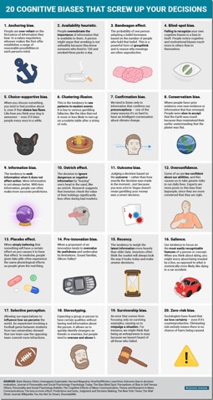
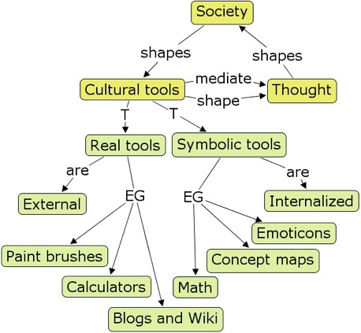
Cultural Challenges and Tools

Slide 42
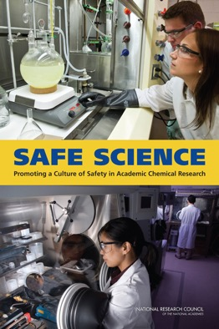
What do we mean by Safety Culture?
Safe Science:
Promoting a Culture of Safety in Academic Chemical Research (2014)
This report was sponsored by:
National Science Foundation,
the U.S. Department of Energy,
the National Institute of Standards and Technology,
ExxonMobil Chemical Company,
E. I. du Pont de Nemours and Company, and
the American Chemical Society.

Slide 43
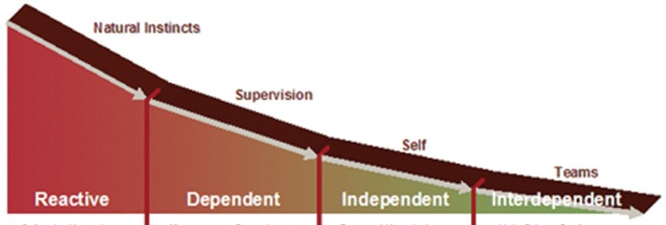
The Role of Risk Assessment in a Safety Culture
Dupont's Bradley Curve
Count of:
Injuries
Rework
Defects
The Focus of the
Risk Assessment Paradigm
National Academy
Safe Science Culture Categories
Pathological:
Power oriented
Safety Bullies
Generative:
Communication
Oriented risk
assessment
Bureaucratic:
"Blame and train"
These cultures will co-exist in an academic institution;
the institution's goal is to move its norm to the right
Notes:
The term "safety culture" has been used increasingly frequently over the last few decades, and its meaning has evolved over that time. One model for an organization's safety culture is provided by Dupont, who describes "safety culture' in terms of 4 stages: Reactive, Dependent, Independent and Interdependent.
Further information about this model can be found at
http://www.dupont.com/products-and-services/consulting-services-process-technologies/brands/sustainable-solutions/sub-brands/operational-risk-management/uses-and-applications/bradley-curve.html
It is not clear if the Dupont model applies well in a decentralized technical community such as found in higher education laboratories. For this reason, information from other sources, such as the safety culture literature outlined in the National Academy's Safe Science report and Dr. Susan Silbey's article Taming Prometheus: Talk About Safety and Culture at
http://web.mit.edu/~ssilbey/www/pdf/safety_culture.pdf
should also be considered as potential models for the laboratory safety culture at UMass are developed and assessed.

Slide 44
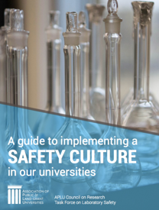
APLU Report Values
1. Safety is everyone's responsibility. It operates at an institutional level.
(community orientation)
2. Good science is safe science.
(productivity)
3. Safety training and education are essential elements of research and education (education)
4. An improved culture of safety is necessary (continuous improvement)
5. Diverse methods and flexible approaches are necessary
(institutionally-driven)

Slide 45
Towards a Safety Culture based on
Leadership and Empowerment
Introductory STEM (supervised)
Mentored undergrad
(overseen on a daily basis)
Graduate
(provided general scientific oversight empowered by safety leadership)
Professional Chemists
(safety leaders expected address novel hazards, support research teams and coordinate with institutional support services)
Safety professional
(liaison to other stakeholders)
Increasing education and responsibility; decreased range of concern

Slide 46
Knowledge, Skills, Culture (Attitude)
Demonstrations and Classes
Webinars
Learning
Knowledge:
Acquisition of information
GHS; CPT Safety Education Guidelines
Skills:
Using information in specific context
Math and Lab Operations; SACL and Prudent Practices
Culture:
Group learning
Community safety awareness; Leadership and empowerment
Classes
ACS and other publications
Story Telling and Videos

Slide 47
A Spiral Learning Approach
to Safety Education
The goal of the spiral is develop the KSAs needed to support the habits of:
- continuous risk assessment (situational awareness),
- documented management choices and - sharing of Lessons Learned.
KSAs
EDUCATION
Research Chemist
Graduate Student
Undergraduate
High School
Lab Skills
Technical
Knowledge
Safety Culture

Slide 48
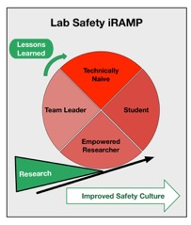
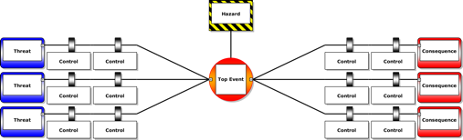
Developing Lessons Learned
Key Considerations:
Who is your audience?
What are you communicating?
How much can they absorb?

Slide 49

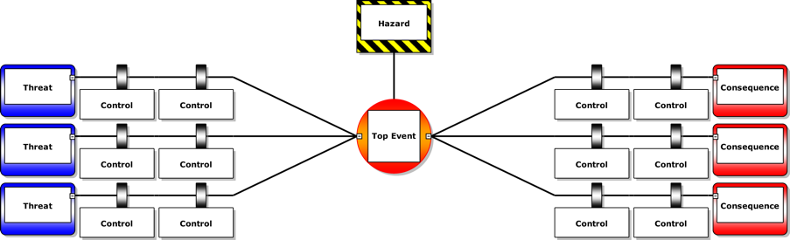

The Next Step: the Bowtie
Excellent communication tool
Not good for hazard identification
Notes:
Talking points:
Why, What and How?
Mary Beth to speak on Context of why we are introducing them into the academic environment (mb to present…this will include using them to identify near misses and how they might relate to questions about safety culture)
Excellent communications tool
Able to illustrate a lot of important information on one page
Simple concepts
Easy to understand at all levels, but…
Easy to get it wrong!
Based on sound scientific principles
Not good for identifying hazards
Even more information can be conveyed
Barriers can be color-coded to show ownership (Operations, Maintenance, Administration, etc.)
Barriers can show strength / effectiveness of each barrier
Deeper functions can link documents – specific procedures, etc.

Slide 50

. . . Flatten them out = Bowtie
Threats ⇒ Prevention Barriers ⇒ Top Event ⇒ Mitigation Barriers ⇒ Consequences
Notes:
To end this segment (Overview of Bowtie), discuss how to read a bowtie.
Depending on time, presenter can either continue on discussing the basic parts/definitions of the bowtie, or save it until after the break.
Bowtie also takes out the complexity of both the Fault tree and Event tree, making it an excellent tool for communication of risk at all levels of the organisation, not only for the experts at the HSE department. Taking out the complexity has some consequences, which we will discuss later on.
Important to note is that the Bowtie method is meant for a higher abstraction level. Whereas Fault trees and Event trees are focused sometimes on the level of a single valve, Bowtie tends to focus on a higher level, and thus provides an excellent overview. It also means that Fault trees and Event trees are not obsolete, they can still be used for a more detailed picture.

Slide 51
Best Practices in Bowtie Development
Identify, in order:
  Hazard / Top Event (most important step)
  Significant Consequences
  Significant Threats
  Preventive Controls
  Mitigation Barriers and Escalation Factors

Slide 52
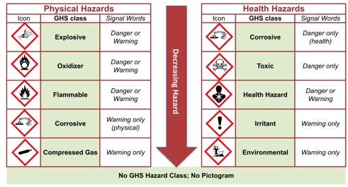
Identifying the Hazards and Top Event
Hazard
The top event in a process is when you have to change your plans
Loss of containment
Loss of external support (e.g. utilities)
Threshold amount is crossed
Top Event Loss of Control
Notes:
If we don’t know what we are trying to avoid, then it will be difficult to build a safety culture that prevents it.

Slide 53
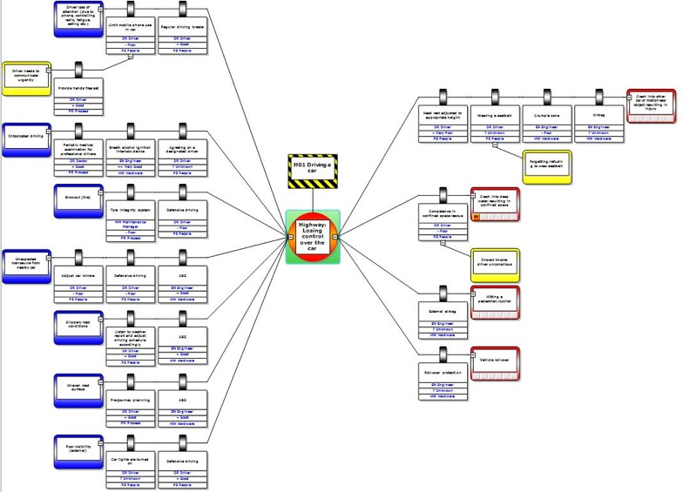
What a Good Bowtie looks like
Large number of routes
Large number of barriers
Only some are critical
Easier to analyze
Easier to communicate
Notes:
In reality, Bow Ties can get quite complicated and they are not as simple as of the earlier figures implied. Nevertheless, they are still easier for communications and explanation than QRA.

Slide 54

  Our Lessons Learned
Science in the 21st Century is changing so fast that a resilient approach to safety is needed
Connect to the Mission (Teaching, Research, Service) rather than the regulations
Connections with other chemistry support roles are valuable – information professionals, educators
  Leverage their skills
  Recognize similar restraints and leverage each other’s strategies
Embedding safety professionals in high risk academic departments if very effective for educating researchers and students about both technical and cultural aspects of chemical safety
The tools are interactive with each other and improve the science

Slide 55
Chemical Safety References
Audience | Technical Resources | Cultural Resources
High school and undergraduate teaching labs | Guidelines for Chemical Laboratory Safety in Secondary Schools, ACS 2016 | Guidelines and Recommendations for the Teaching of High School Chemistry, ACS 2012
Mentored research labs (REU, CURE, similar programs) | Safety in Academic Chemistry Laboratories (SACL), 8th edition ACS 2017 | Creating Safety Cultures in Academic Institutions ACS, 2013
Supervised research (graduate school) | Guidelines for Chemical Lab Safety in Academia, ACS 2016 | A Guide to Implementing a Safety Culture in our Universities APLU, 2016
Research leadership | Prudent Practices in the Laboratory National Academies Press 2011 Hazard Assessment in Research Laboratories ACS, 2016 | Safe Science National Academies Press, 2014 Safety Guidelines for the Chemistry Professional ACS DCHAS / CCS, 2017

