Slide 1
Hazard Analysis in Academic Research Laboratories
Meeting Chemical Safety Expectations in Instructional Laboratories CHAS Workshop
Samuella B. Sigmann, NRCC-CHO
Appalachian State University
Boone, NC
251st ACS National Meeting,
San Diego, CA
March 12, 2016

Slide 2
After a few laboratory courses, students have developed some basic knowledge about hazards, but have relied on following rules to minimize risk.
As experiments and processes become more advanced in upper level undergraduate courses and research, the hazards become greater, more complicated, and more complex.
The rules must evolve from a list of “dos and don’ts” to learning about assessing risk based on the hazards
Wear PPE
Is PPE
Required?
Is PPE Enough?
General Rule
Access
Risk
Manage
Risk
Which PPE?
Lessons Learned

Slide 3
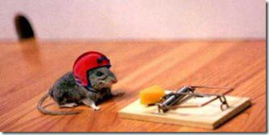
Recognizing Hazards & Understanding Risk

Slide 4
What is a Hazard?
Simply stated, a hazard is a potential for harm
It can be a condition or an activity – Broadly grouped this includes natural phenomena, chemicals, processes, sources of energy, situations and events
Hazards left uncontrolled can result in injury, illness, loss of property, and/or environmental damage – these are consequences
A hazard is an intrinsic property of the agent, condition, or activity – there either is or is not a potential for harm

Slide 5
ALL chemicals have hazards – That is; they all have a potential for harm!
That does not mean one should not work with chemicals.
Chemicals are the tools of chemists, and therefore as a chemist you must learn HOW to work safely with your tools.

Slide 6
Understanding Health Hazards
LD50 Rat oral 3000 mg/kg
NaCN
LD50 Rat oral 6440 ug/kg
NaN₃
LD50 Rat oral 27 mg/kg
NaCl
We have to talk about toxicity or what amount of the chemical causes adverse affects

Slide 7
Dose
$$Dose= \frac{Amount of Toxicant}{Kilogram Body Weight}$$
LD50 Rat oral 3000 mg/kg
NaCN
LD50 Rat oral 6440 ug/kg
NaN₃
LD50 Rat oral 27 mg/kg
NaCl

Slide 8
What is Risk?
Risk is the probability of an adverse consequence occurring from an existing hazard
Risk is not an intrinsic property
There are 3 components to consider
Likelihood
Exposure
Consequence severity
You can reduce risk

Slide 9
Risk (cont.)
Likelihood = measure of how likely the occurrence of a complete sequence of events leading up to a consequence is upon exposure to a hazard
This component is often associated with descriptors such as: rare; unlikely; possible; likely; almost certain
For chemicals, exposure must consider the nature of the chemical and how it is being used
Toxicity, route of entry, chemical form, length of exposure, etc.
Severity of consequence
first aid to death / $ $
Also consider physical hazards of chemicals

Slide 10
Which is a greater risk of use?
NaCl
Consuming 0.5 lbs of sodium chloride
Driving in a car with an airbag containing 130 g of sodium azide
NaN₃

Slide 11
The terms hazard and risk are not synonymous. Because a hazard is an intrinsic property of a substance or condition, the potential for harm is always present.
By implementing appropriate controls, the risk associated with identified hazards can be reduced or eliminated.

Slide 12
For example, benzene is a known human carcinogen and therefore exposure to benzene in laboratory work poses a health risk.
If one works with laboratory scale amounts of benzene in a properly functioning fume hood, the likelihood of exposure is low or eliminated, thereby minimizing risk.

Slide 13
In most industries where hazards exist, projects cannot proceed without a written hazard analysis and risk assessment.
Compare this to…

Slide 14
….academic research laboratories where the implementation of hazard identification as a formal (or even informal) step in the research process is rarely done

Slide 15
Why?
The changing nature of academic research
Lack of change control
Change control or change management is the management process for requesting, reviewing, approving, carrying out, and controlling changes to agreed upon deliverables or operational boundaries
Example: A PI in an academic lab orders hydrofluoric acid for a new project. The lab where they are working does not have an established designated area.

Slide 16
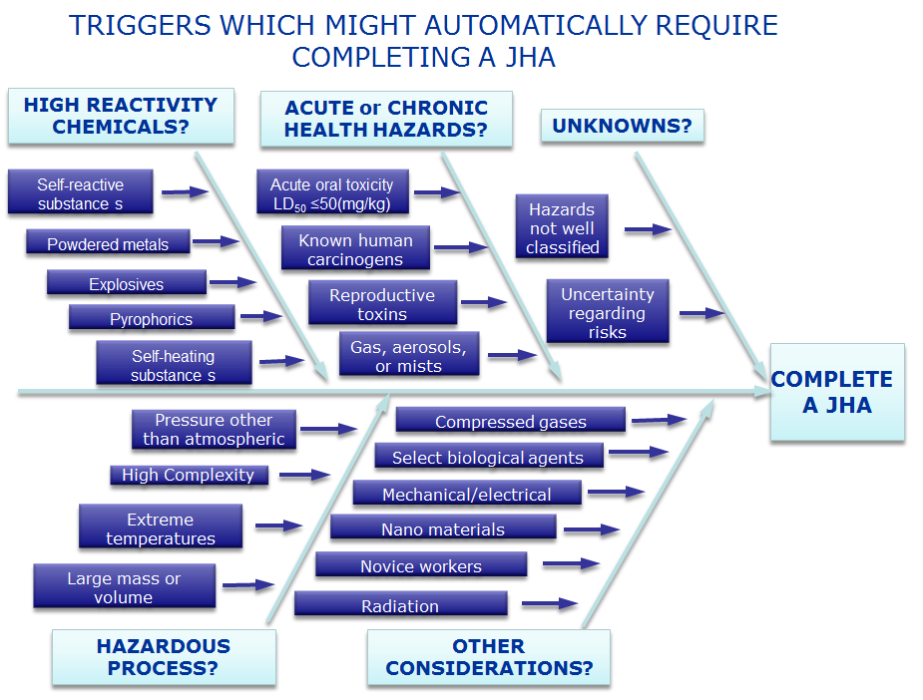

Slide 17
Change Drivers
Significant changes that can impact an the risk associated with an experiment

Slide 18
Change Drivers
Addition of a new technique
Creation of materials with unknown hazards
New person on team or loosing someone with experience
Same task but in a new location
Changes in ambient conditions (more humidity, less control on temperature)
Finding that something you thought would be available is not or something you didn’t expect to be available is
Psychological state of workers (stress, fatigue, etc.)
Same reaction, but new reactants or solvents
Failure of current experimental parameters
Age, concentration, or contamination of chemicals
New piece of equipment
Modifications to equipment or the way the equipment is used (will it be used the way the manufacturer intended?)
Scale up
Incorporation of new technology

Slide 19
What’s Your Risk Response?
Below are two sequences recorded from several coin tosses. Which one seems more likely?
H T H T H T H T H T H T H T
H H T H T T H T T T H H H T

Slide 20
H T H T H T H T H T H T H T
H H T H T T H T T T H H H T
Both “a” and “b” have the same number of heads and tails
The likelihood of the each pattern occurring is the same
Most people choose “b” because it looks random and we expect probability to be random
Each toss is independent of the previous or next and there is a 50/50 chance on each toss for h/t and the coin does not “remember” what it did the last time…

Slide 21
… but we do – and we use our expectations of probability patterns to predict what to expect will happen next
So how does this information relate to hazards in the lab?

Slide 22
A Practical Application of this…. Why is Ethyl Ether Stored Under Refrigeration?
When I asked researchers this question, most answered, “Because that is how I was taught and I have always done it this way. Nothing bad has ever happened.”
This logic would be represented by the following coin toss H H H H H H H H H H
One day the bottle is opened and the peroxides detonate.
So now we have…
H H H H H H H H H H T (Boom)

Slide 23
So what happened?
In many labs, ethyl ether is stored in a refrigerator
The logic being that ether is very flammable because it is volatile. Keeping it cold will reduce the vapor pressure making it less flammable
The problem is that the peroxides that can form when ether is exposed to air freeze at a higher temperature than the solvent. Thus the solid peroxides will precipitate at refrigerated temperatures and make the solvent more dangerous for detonation.

Slide 24
'— but there's one great advantage in it, that one's memory works both ways.'
'Living backwards!' Alice repeated in great astonishment. 'I never heard of such a thing!'
'I'm sure mine only works one way,' Alice remarked. 'I can't remember things before they happen.’
‘It's a poor sort of memory that only works backwards,' the Queen remarked.
'What sort of things do you remember best?' Alice ventured to ask.
‘Oh, things that happened the week after next,' the Queen replied in a careless tone.
Through the Looking Glass, by Lewis Carroll

Slide 25
Stages of Learning
Unconscious incompetence → You don’t know what you don’t know
Conscious incompetence → You realize you don’t know what you don’t know
Conscious competence → You have the knowledge, but have to think to execute
Unconscious competence → You are very knowledgeable and experienced regarding the subject at hand and the practice is rote

Slide 26
Bounded Rationality
Our perception of risk limits our decision making capabilities
We constantly use what we know to make fast decisions about things that involve risk
Many times, “what we know” is not enough to make an informed decision, but we do it anyway
We either don’t have all the facts, or we don’t have the intelligence (or training) to understand all the facts

Slide 27
How to Make Better Decisions in the Laboratory
Be vigilant about recognizing change
Ask questions and challenge co-workers
Establish boundaries
Communicate with all member of the lab group on a regular basis
Report near misses – or more accurately “near hits”
Include hazard information in notebooks, weekly meetings, presentations, and papers
Perform a hazard analysis

Slide 28
Controlling Hazards to Reduce Risk

Slide 29
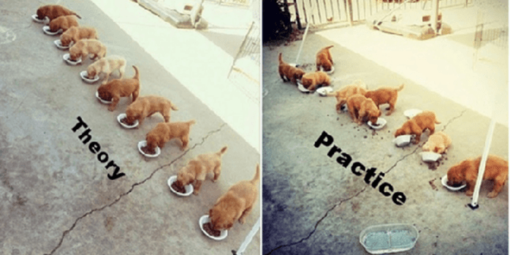

Slide 30
Selection of Hazard Controls
There is a “hierarchy of control” that is the order in which controls should be applied to most effectively reduce risk
The truth is that often controls must be combined to obtain an acceptable level of risk

Slide 31
The initial design of the facility, equipment, chemicals or process to remove hazards
Implementation of procedures and policies (SOPs, LOTO), training, reducing exposure times, attention to susceptible employees, signage, best work practices, not working alone, etc.
Gloves, respirators, aprons, lab coats, goggles, ear plugs, face shields, etc.
Water based solvent vs. organic , lower reaction temp or pressure, less toxic reactants, etc.
Ventilate or isolate with timing, hoods, gloves boxes, bio safety cabinets, snorkels, safety interlocks, lead shielding, inert atmospheres, guarding, etc.
Control Hierarchy
Elimination
Engineering
Personal Protective Equipment
Administrative
Substitution

Slide 32
A word about PPE Controls
PPE is the last line of defense, for if it fails, you have exposure. PPE is acceptable as a control method when
Engineering controls are not feasible or they do not totally eliminate a hazard
As a temporary control while engineering controls are being developed
If engineering and administrative controls cannot provide sufficient protection
In emergency situations

Slide 33
Hazard Assessment Tools
Standard Operating Procedures (SOPs) – Are used to limit exposure when the hazards are known
Hazard Analysis Tools
Job Hazard Analysis (JHA)
Chemical Safety Levels (banding)
What If Analysis
Checklists
Barrier Analysis

Slide 34
JHA
TASK
WORKER
ENVIRONMENT
TOOLS

Slide 35
A Starting Place
OSHA Publication 3071
(2002 Revision)
The information in OSHA Publication 3071 (first published in 1989) was used as a general guide for our work.
ISBN-13: 978-1478107507
Public Domain

Slide 36
Once hazards have been identified, risk can be determined, and controls can be established.

Slide 37
Preparing a jha
Part II

Slide 38
JHA Preparation Tactics
Outline the steps or tasks in each priority project
List, rank, and set priorities for research projects based on hazard(s)
Trigger(s) Identified
Assign risk to each task in priority project
Review accident histories in the lab and at institution
Pick highest
risk project
Assign appropriate controls to mitigate or eliminate the hazard
Conduct a literature review & preliminary job review of current tasks and conditions
Write a description statement for the project – what is being done and why
Prepare JHA

Slide 39
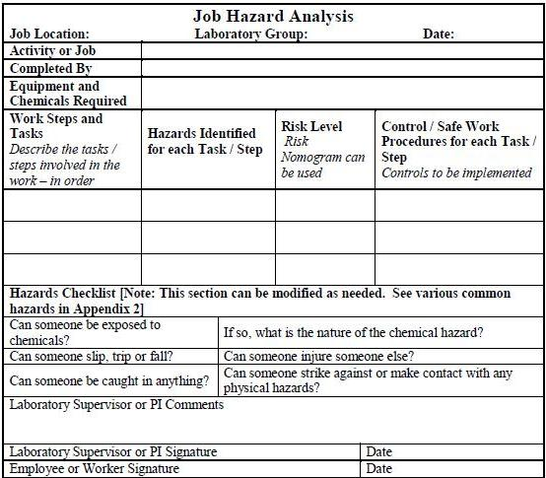
JHA Basic Template

Slide 40
Write a Work Summary –
Describes the activity to be performed
Where will the activity take place?
What equipment & chemicals are required?
What processes will need to occur? Setting up equipment, dispensing chemicals, etc.

Slide 41
Assign ing risk

Slide 42
Score Calculator A Nomogram for Calculating Risk
Riskex Nomagram

Slide 43
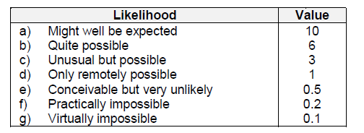
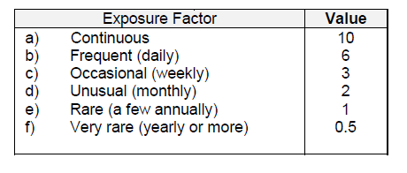

Slide 44
A well designed tool will always include…
Where the hazard is happening?
(the environment),
Who or what it is happening to?
(the exposure),
What precipitates the hazard?
(the trigger),
The outcome that would occur should it happen?
(the consequence), and
Additional contributing factors?
(fatigue, time, weather, experience, etc.).

Slide 45
Inadequate Descriptions | Adequate Descriptions
TASK
HAZARD
CONTROL
Extraction of caffeine from coffee beans with diethyl ether followed by TLC
Work in chemistry lab
Chemical splash – corrosive; eye damage; inhalation
Chemical spill
Chemicals
Nitrile gloves provide adequate protection for incidental exposure to diethyl ether
Wear gloves

Slide 46
Additional Information to Include
Regulatory information (OSHA standards; EPA standards; DOI standards)
Previous accidents; Emergency response information; phone numbers
Where to find additional information

Slide 47
Convert JHA to Narrative Form
Add 30 mL of concentrated nitric acid to copper wire in beaker
Nitric acid is a reactive oxidizing acid and very reactive with organic materials. Review your SOPs or SDSs for the acid prior to use to familiarize yourself with the known hazards of this acid.
Check for reaction completion
You must ensure that all the Cu wire has completely dissolved so that the prepared stock solution is actually 1000 ppm.
While nitrile gloves may provide sufficient protection against incidental splash, documented sources show a low breakthrough time for this material (The breakthrough time for nitrile gloves is <5 minutes. From ChemIDPlus Advanced [HSDB]) so double glove or use an alternate glove material such as polyethylene.
Make certain that you know the location and use of neutralizing components of your spill kit.
Breaking a large reagent bottle of concentrated nitric acid may result in a HAZMAT situation, so review your ER procedures.
You must work in a chemical fume hood, because a noxious, toxic gas (NO₂) will be evolved during this process. Stirring with a magnet/stir plate will assist with the dissolution of the gas.
After the gas has evolved (the solution should be the typical blue color of copper(II) and not green which indicates gas is still present).
Close inspection may require a face shield, but DO NOT HOLD OVER YOUR FACE.

Slide 48
Job: Change a ceiling light bulb
For this job you will be replacing an incandescent bulb with a compact fluorescent one. This job requires an 8 ft step ladder that must be obtained in the garage and moved to the house.

