Slide 1


Division of Chemical Health and Safety(CHAS)
Strategic Planning Retreat (Gen 2)
Sept. 6, 7, & 11, 2023
Virtual Platform
V
Vision
Improving all people’s lives through the transforming power of chemistry
Facilitators:
Carol Duane
Larry Krannich
Notes:
Welcome all to the Retreat.
Join Zoom Meeting
https://zoom.us/j/93320384654?pwd=cldCTkZlNUtlVENvdUl4TmEzTlRjUT09
Meeting ID: 933 2038 4654
Passcode: 6ubWMV
Introduce Carol, Larry as co-facilitators.
Introduce the Participant Guide— most of the slides, some slightly modified
Also – Appendices have curated pre-work responses.

Slide 2


Core Values: Passion for chemistry; Focus on members; Professionalism, Safety, & Ethics; DEIR
CHAS 2023 Strategic Plan*
Vision
Goals & Strategies
Protecting people and the planet through excellence in chemical health and safety
Mission
Goal 2: Communicate Best Safety Practices. Through technical programming, education, recognition, and outreach, advance and communicate best safety practices and their value.
G2S1: By 2025, expand technical programming through co-sponsorship of symposia with other Divisions. I,H; R,M. Champion: Debbie & Mary Beth
G2S2: By the end of 2024, work collaboratively with national ACS, CCS, ACS Publications, ACS Chemical Health and Safety, and Chemical Abstract Services, to implement best practices and amplify health and safety resources using databases, e-publications, and web presence. I,H; R,L. Champion: Marta & Michael
G2S3: By the end of 2024, increase participation and marketing of CHAS in Communities, other Divisions, local section, and regional meetings by offering a wide array of safety activities such as outreach, workshops, and other recognition-focused initiatives. I,H; R,M. Champion: Dan
Foster a collaborative global community that promotes best practices in chemical health and safety.
Goals & Strategies
Goal 1: Cultivate Community. Establish and implement a framework and infrastructure to recruit, onboard, mentor, retain members, and foster internal and external collaborations.
G1S1: Evaluate current governance and committee structure and subsequently restructure in alignment with the strategic plan within the next 6 months. I,H; R,M. Champion: Sammye
G1S2: Establish "CHAS Communities" program including Community charters and Community leadership guide by within the next *6 months. I,H; R,M. Champion: Robin & Kimi
G1S3: Build a communications network that incorporates email, webpage, and social media and targets the division as a whole, the CHAS communities, ACS members, and the general public. I,H; R,H. Champion: Robin & Calla
G1S4: Attract new members by clearly defining CHAS Value Propositions and engage them with a formal onboarding process. I,M; R,M. Champion: Jack & Kimi
Goal 3: Develop Leaders. Develop leaders in chemical safety in the division, the health and safety profession, and the chemistry enterprise
G3S1: Design and implement a comprehensive leadership development program for CHAS. I, H; R, M. Champion: Frankie
G3S2: Establish a member mentoring program. I, M/H;R,M Champion: Frankie & Russ
G3S3: Create organized strategy for educational offerings from student to researcher to safety practitioner levels, with a clear schedule that is properly promoted and advertised. By Q1,25. I,H; R,M. Champion: Russ & Kali
*As approved by XXX, date
Notes:
YOUR PLAN
3 STRATEGIC Goals, each with 3 IMPLEMENTATION strategies TO START IN THE FIRST 6-12 MONTHS
By the end of this retreat, we’ll have something similar for your unit.

Slide 3
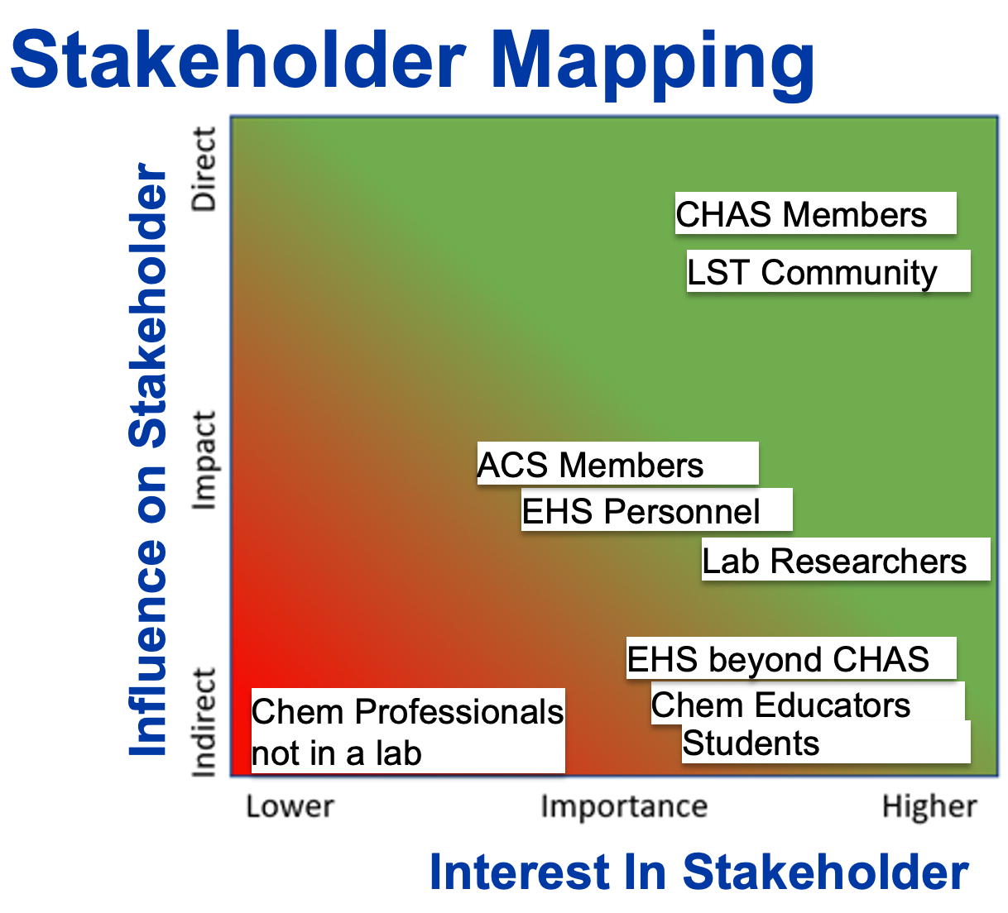
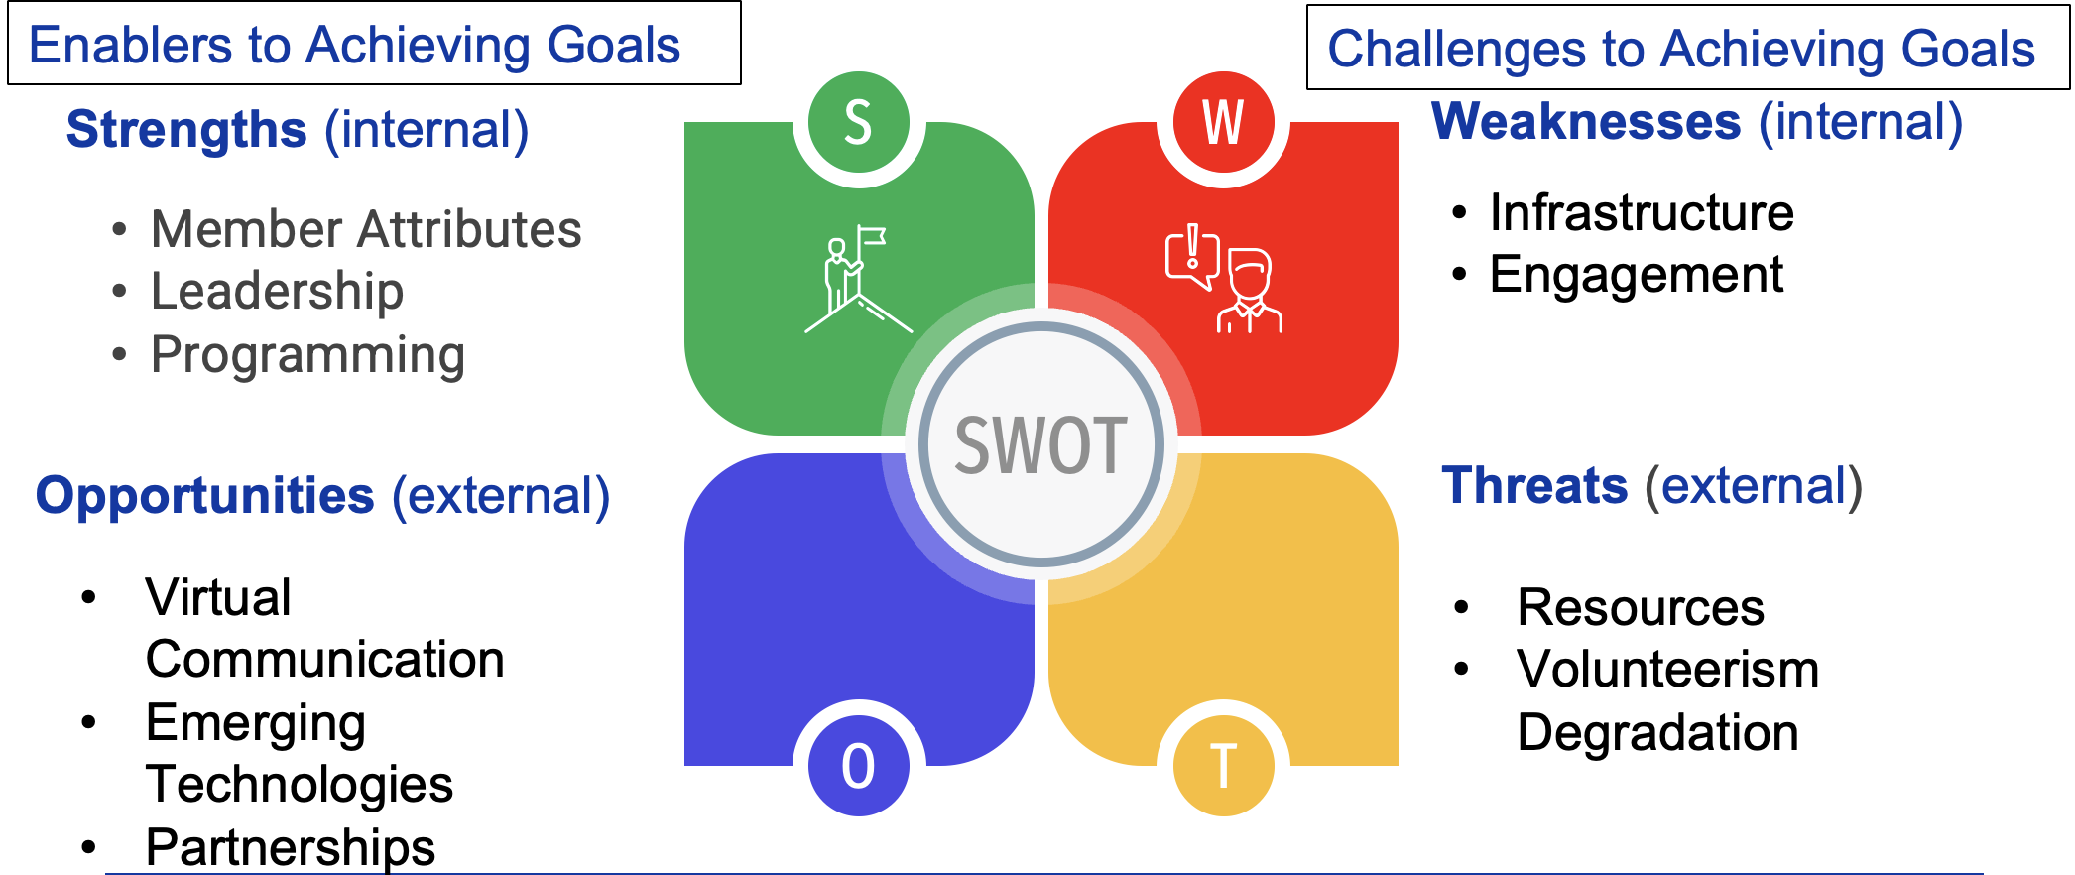
CHAS 2023 Dashboard
Core Values: Passion for chemistry, Focus on members, Professionalism, Safety, Ethics, DEIR
SWOT matrix
Vision: Protecting people and the planet through excellence in chemical health and safety.
Mission: Foster a collaborative global community that promotes best practices in chemical health and safety.
Goals:
Goal 1: Cultivate Community. Establish and implement a framework and infrastructure to recruit, onboard, mentor, retain members, and foster internal and external collaborations.
Goal 2: Communicate Best Safety Practices. Through technical programming, education, recognition, and outreach, advance and communicate best safety practices and their value.
Goal 3: Develop Leaders. Develop leaders in chemical safety in the division, the health and safety profession, and the chemistry enterprise.
*As approved by the xxx, date
Notes:
Blank Dashboard for Unit if using.

Slide 4
Expectations for This Strategic Planning Retreat One Word!
ENERGIZED
ROADMAP
ENGAGEMENT
PROGRESS
BRIDGES
CLARITY
AMPLIFY
ACCOUNTABILITY
ACHIEVABLE
DIRECTION
PRIORITIZE
DECISIONS
COHESION
RESET
DEFINITION
Notes:
11:05 – 11:15
Intros and Expectations

Slide 5
Parking Lot
TAG LINE – MEET!
‘TRAINING FOR STAFF
Info repository
REVISIT G3S1 AND G3S2 PROJECT PLANS
Refocus G2S3 strategy statement
Notes:
In order to keep things moving—we’ll use a parking lot, to park conversations, topics that you can revisit after the retreat.

Slide 6

Strategic Planning Retreat Process
STEP 6
STEP 1
IMPLEMENTATION
RETROSPECTIVE ANALYSIS, STAKEHOLDERS, VISION & MISSION
STEP 5
PROJECT PLANS
STEP 2
GOALS
STEP 4
STEP 3
STRATEGIES PORTFOLIO
SWOT ANALYSIS
Notes:
This shows the critical components of the retreat, and the order in which we’ll develop your strategic plan.

Slide 7
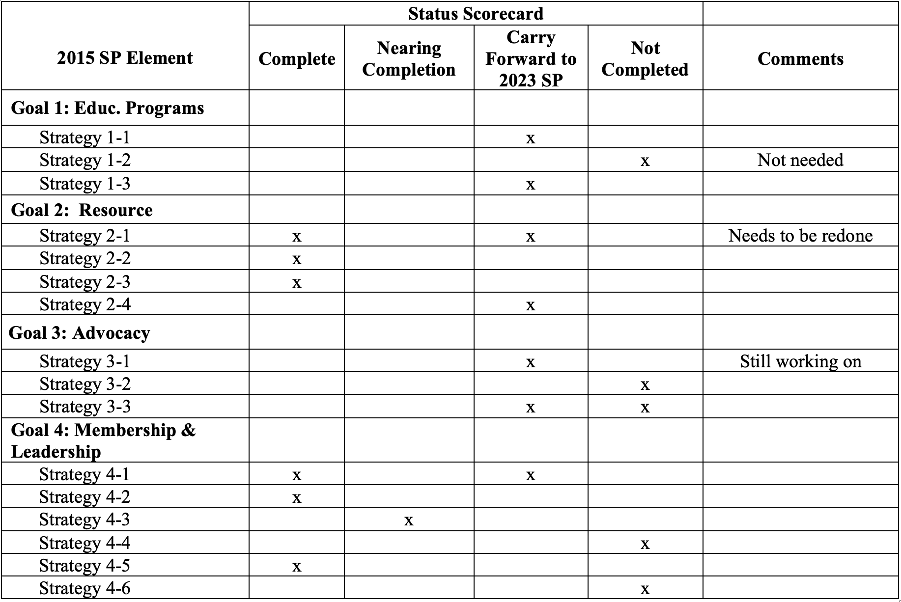

Slide 8
What Went Well vs Not as Well
(Appendix F and G)
Focus | Count
Resource (Goal 2) | 8
Sponsorships (Goal 1) | 6
Advocacy (Goal 3) | 4
Focus | Count
Website Design (G2S1) | 3
Advocacy (Goal 3) | 3
Champion's Situation | 2
Education Offerings | 2
Increasing Membership | 2
Notes:
In the pre work you were asked “What are the biggest successes with your current SP?” (to list what you believed went especially well in working with the previous plan). Those responses can be found in Appendix F and have been categorized here. Are there any others that you have thought about and should be captured? [If so, capture these in real time.]

Slide 9
What We Might Do Differently (Appendix H)
Focus | Count
SP Monitoring | 3
Audience Scope | 2
Enhanced Involvement | 2
Visibility | 2
More Focused | 2

Slide 10
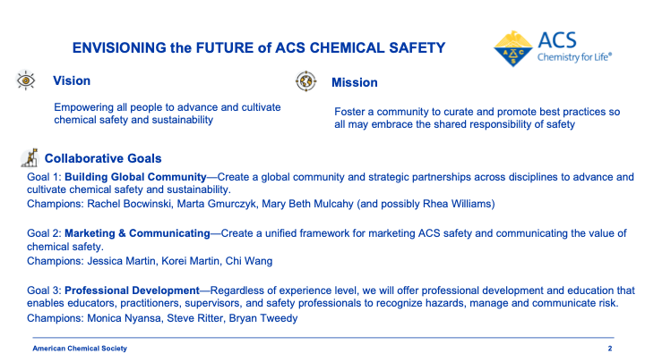
Collaborative Group of Governance units’ reps (CHAS, CCS, & CHED) with ACS Office of Safety Programs; July 28, 2023, workshop

Slide 11
CHAS Bylaws – Effective 2006
Objects of CHAS
Focus information on the properties of chemicals that affect humans directly or through the environment
Monitor the technical aspects of the above
Develop symposia and general sessions of topics related to the above at national, regional, divisional, and other meetings of the SOCIETY
Foster publication and other modes of dissemination of information pertaining to the above,
Provide expertise in chemical health and safety to the SOCIETY and, in the public interest, to others as specified in the Charter of the SOCIETY

Slide 12
CHAS Stakeholders
Pre-Work Output [Appendix I]
Count | Stakeholder Group
8 | EH&S Personnel
6 | Chemistry Professionals
6 | Laboratory Researchers
5 | CHAS Members
4 | ACS Members
4 | Chemistry Educators
Notes:
This gives the primary stakeholders from Pre-Work. The results of your stakeholder analysis are found in Appendix xx of the PG.
We will discuss these in terms of the Stakeholder Mapping and determine whether each status is realistic.

Slide 13
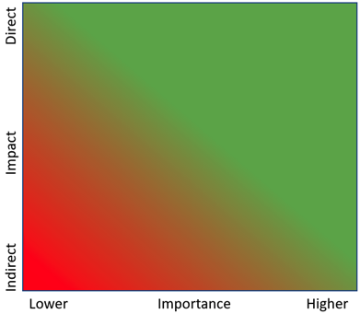
Stakeholder Mapping
CHAS Members
LST community
Influence on Stakeholder
ACS Members
EH&S Personnel
Lab researchers
EHS beyond CHAS
Chem Professionals – not a lab researcher
Chem Educators
students
Interest In Stakeholder
Notes:
12:00 – 12:30 30 minutes
Who is or should be the stakeholder of most importance and where you can have the greatest influence?
Allocate all? Or pick the top 3-4
Take a poll to assess participants extent of support for this map.

Slide 14

Final CHAS Vision Statement
Vision: Protecting people and the planet through excellence in chemical health and safety.
Copy to Dashboard
Notes:
This is 80/20
Can always wordsmith this
This is big, bold, vague, which is great
[If there are 2 or 3 statements and no consensus, take a formal weighted vote to identify top statement]

Slide 15
Final CHAS Mission Statement
Mission: Foster a collaborative global community that promotes best practices in chemical health and safety.
Copy to Dashboard
Notes:
Follow this formula: What are you doing? (for Whom) and Why?
What are you doing: Fostering a diverse and collaborative community
Why? To promote discovery and transformation at the intersection of chemistry and biology

Slide 16
CHAS Identified Goal Themes
Cultivate Community
Communicate Best Safety Practices
Develop Leaders
Next Step: Goal Statements

Slide 17
Final Goal Statements
Goal 1: Cultivate Community. Establish and implement a framework and infrastructure to recruit, onboard, mentor, retain members, and foster internal and external collaborations.
Goal 2: Communicate Best Safety Practices. Through technical programming, education, recognition, and outreach, advance and communicate best safety practices and their value.
Goal 3: Develop Leaders. Develop leaders in chemical safety in the division, the health and safety profession, and the chemistry enterprise.
Copy to Dashboard
Notes:
To fill in during retreat: Put in Final wording using 80/20.

Slide 18
SWOT Analysis CHAS Division
Enablers to Achieving Goals
Challenges to Achieving Goals
Strengths (internal)
S
W
Weaknesses (internal)
Member Attributes
Leadership
Programming
Infrastructure
Engagement
SWOT
Opportunities (external)
Threats (external)
Virtual Communication
Emerging Technologies
Partnerships
Resources
Volunteerism Degradation
O
T
Notes:
Record top 3 Strengths, Weaknesses, Opportunities, Threats on this chart.

Slide 19
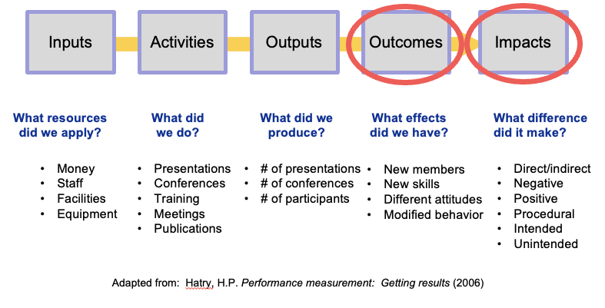
Metrics: Performance Measurement Model
Notes:
This is a model some non-profits use to think about measurement of progress toward a goal (Describe the 5 dimensions). It contains 5 factors you can consider measuring.
ASK: Do we need to measure all 5” (No. Measure the minimum you need to…can cost more time/$ than the initiative itself.)
ASK: Which is easiest? (inputs) Which is most difficult/expensive? (Outcomes & Impacts)
Most common problem: measuring activities (“busyness”) & outputs (Counting the busyness”) rather than RESULTS (OUTCOMES/IMPACT)
Why do we want to focus on outcome measurement
To understand the desired outcome of the goal (not the steps you take to get there)
To evaluate the impact that the goal had on the targeted audience
Performance metric measures the key activities that lead to successful outcomes.
Performance metrics are analyzed on an ongoing basis to make sure your work is on track to hit the target. If you don’t reach your performance metrics, you know that you will not meet your outcome metric. Fortunately, performance metrics help you make changes to alter the ultimate outcome.

Slide 20

How are metrics/measures developed?
First, determine the desired outcome(s) of the goal-strategy
  What impact will the results have on the target audience?
  What would success look like?
Second, ask:
  How would performance be measured?
  What indicators would be needed?
Notes:
What gets measured gets done, but we need to make sure the right work gets done.
Answers to these questions should produce good measures

Slide 21
CHAS Div Identified Strategy Areas for each Goal
Goal 1 Cultivate Community
G1S1 – Framework/Infrastructure
G1S2 – Collaboration
G1S3 – Communications
G1S4 – Membership Growth
Goal 2: Communicate Best Safety Practices
G2S1 - Collaboratives
G2S2 - Collaboratives
G2S3 – Outreach/Marketing/Recognition
Goal 3: Develop Leaders
G3S1- Leadership Development
G3S2 – Mentoring/Partnering
G3S3 – Professional Development
Notes:
These represent the strategy areas for your three goals that you will use in writing your strategies for these goals.

Slide 22



SMARTIE Goal/Strategies
I
E
Inclusive
Equitable
/ S T R A T E G I E S
Source: Management Center
Notes:
S.M.A.R.T Goal/Strategies:
The ‘SMART’ criteria ensure that the goals you set for your project are critically analyzed. It is an established method that reduces risk and allows managers to make clearly defined and achievable goals.
The acronym SMART stands for [SEE GRAPHIC]
Specific: Identifies a specific action or event; unambiguous.
Measurable: Strategy/Benefits are quantifiable; specific criteria that measure progress
Achievable: Attainable with available resources.
Relevant: Within reach; Aligned with your mission, and with other efforts and needs.
Time-bound: States definite time frame or timeline when it will be accomplished.:
Inclusive:
Equitable:
We will want to make Goal statements and strategies “SMART

Slide 23
Goal 1 – Strategy Statements
Goal 1: Cultivate Community. Establish and implement a framework and infrastructure to recruit, onboard, mentor, retain members, and foster internal and external collaborations.
G1S1: Evaluate current governance and committee structure and subsequently restructure in alignment with the strategic plan within the next 6 months. I,H; R,M. Champion: Sammye
G1S2: Establish "CHAS Communities" program including Community charters and Community leadership guide by within the next *6 months. I,H; R,M. Champion: Robin & Kimi
G1S3: Build a communications network that incorporates email, webpage, and social media and targets the division as a whole, the CHAS communities, ACS members, and the general public. I,H; R,H. Champion: Robin & Calla
G1S4: Attract new members by clearly defining CHAS Value Propositions and engage them with a formal onboarding process. I,M; R,M. Champion: Jack & Kimi

Slide 24
Goal 2 – Strategy Statements
Goal 2: Communicate Best Safety Practices. Through technical programming, education, recognition, and outreach, advance and communicate best safety practices and their value.
G2S1: By 2025, expand technical programming through co-sponsorship of symposia with other Divisions. I,H; R,M. Champion: Debbie & Mary Beth
G2S2: By the end of 2024, work collaboratively with national ACS, CCS, ACS Publications, ACS Chemical Health and Safety, and Chemical Abstract Services, to implement best practices and amplify health and safety resources using databases, e-publications, and web presence. I,H; R,L. Champion: Marta & Michael
G2S3: By the end of 2024, increase participation and marketing of CHAS in Communities, other Divisions, local section, and regional meetings by offering a wide array of safety activities such as outreach, workshops, and other recognition-focused initiatives. I,H; R,M. Champion: Dan

Slide 25
Goal 3 – Strategy Statements
Goal 3: Develop Leaders. Develop leaders in chemical safety in the division, the health and safety profession, and the chemistry enterprise.
G3S1: Design and implement a comprehensive leadership development program for CHAS. I, H; R, M. Champion: Frankie
G3S2: Establish a member mentoring program. I, M/H;R,M Champion: Frankie & Russ
G3S3: Create organized strategy for educational offerings from student to researcher to safety practitioner levels, with a clear schedule that is properly promoted and advertised. By Q1,25. I,H; R,M. Champion: Russ & Kali

Slide 26
Opportunity Map For CHAS
Avoid
Pursue selectively
G1-S3
Hi
Discussion is needed to determine the schedule for those in the “Pursue selectively” quadrant.
G3-S3
G3-S1
G1-S2
Resources
G2-S3
Tactical
(incorporate into routine)
No-brainers
(unfortunately few of these)
G1-S4
G3-S2
G1-S1
G2-S1
G2-S2
Lo
Lo
Probable impact
Hi

Slide 27
Strategic Plan Champions
What | Champions
Goal 1, Strategy 1 | Sammye
Goal 1, Strategy 2 | Robin & Kimi
Goal 1, Strategy 3 | Robin & Calla
Goal 1, Strategy 4 | Jack & Kimi
Goal 2, Strategy 1 | Debbie & Mary Beth
Goal 2, Strategy 2 | Marta, Michael
Goal 2, Strategy 3 | Dan
Goal 3, Strategy 1 | Frankie
Goal 3, Strategy 2 | Frankie & Russ
Goal 3, Strategy 3 | Russ & Kali
STRATEGIC PLAN | Chair succession
Notes:
Complete this with the Goal/Strategy Champions and ID the Champion(s) for the overall Strategic Plan. For a Committee, the Champions for the Strategic Plan should be the subcommittee chairs.
Complete this with the Champions. Ask the group to divide up into three groupings at separate tables, with each Goal 1 strategy champion at a separate table. Allow 15 minutes to complete the Project Plans for Goal 1 strategies.
Return to this slide when they organize to do Goal 2/Strategy combination Project Plans and Goal3/Strategy combination Project Plans.

Slide 28
Project Plans Report Out
Present (5-7 minutes) your plan’s salient points; for interconnectivity
Critique each project plan for
  Achievability
  Realistic
  Interconnectivity
  Measurement
Approve each project plan & the portfolio
Portfolio will be Forward to Chair for loading on Google Drive

Slide 29

Successfully Accomplishing Plans and Goals
Goal clarity and vision
Planned and organized
Time-bounded
Follow-through
Importance
Accountability
Anticipation of barriers and risks
Recovery plans

Slide 30
Some Common Implementation Pitfalls
Trying to do it all yourself; not delegating
No accountability system
Not assessing and managing available time
Not involving other members
Not getting buy-in
Measuring activities instead of outcomes
Not developing timelines and milestones
Not developing detailed project plans for strategies
No follow-up between meetings
Not using volunteers’ motivations when engaging volunteers for their skills
Not monitoring the progress of the strategic plan
Not celebrating successes
Notes:
Notes –

Slide 31
Monitoring Strategic Plan Progress
Develop Milestones/Timelines
  Overall Strategic Plan
  Individual Goal/Strategies
Tracking and Reporting Monthly Progress

Slide 32

Next Steps for CHAS Strategic Plan
What | Who | When | Comments
SPR Attendees Receive Plan | Facilitators | 48 Hours
CHAS Approves 2023 CHAS Strategic Plan | EC | Nov. mtg
Repository for Project Plans | Mary Beth/ Sammye | Oct. 1 | Basecamp, each GxSx has own folder
Accountability process identified | Project Leads to EC | Monthly
Project Leads and Teams Identified | Champions | Oct. 15 | Group will organize to discuss
Sharing plan with relevant membership
Team members meet to “finalize” Project Plans |  | Jan1
”Champion” for overall Strategic Plan | Chair Succession | Done
KICK OFF |  | Nov. mtg
Notes:
Notes:

Slide 33
Retreat Feedback
Organization
Took time for 4 sessions
Were productive
True to the process
Collegiality
Less time on others’ M/V, more on Goals/Strategies
Do the homework during a session
More material to cut and paste
Prework emphasized others’ M/V…..
Ability of new and emerging leaders to contribute
A round robin when doing strategies
Setup breakout rooms to work on Project Plans
Assign a “chat keeper”

Slide 34

Don’t Forget to Celebrate Success!

Slide 35


End Of
CHAS
VSPR
Notes:
End by noon

